Slide 1



Cybersecurity awareness
Security, safety and hygiene
Classification: Confidential

Slide 2


Background to the CoE
IISc is the Anchor institute
Initiative of GoK, Department of IT, BT, S&T and Karnataka Innovation and Technology Society
KSCST is the Implementation Agency

Slide 3





CySecK Programme structure
Awareness
Skill building
Research Collaboration
Industry and startups
Government
  Cybersecurity awareness to citizens
  Cybersecurity awareness to school students
  Cybersecurity awareness for GoK staff
  Technology community (students / working professionals)
  Faculty development programme
  Create a marketplace for cybersecurity courses
  Community cyber lab
  Research Grant Programme – for top institutes
  Research Development Programme for Tier 2 institutes
  Cybersecurity startup accelerator
  Development of standard specifications / best practices / reference architectures
  Cybersecurity awareness to MSME sector
  Policy advocacy for enabling industry
  Provide cybersecurity assistance / guidance to state government entities
  Support the Dept with actionising Cyber Security Strategy
  Provide technical support to K-CSIRT

Slide 4
Why is Cybersecurity important?
A philosophical view

Slide 5

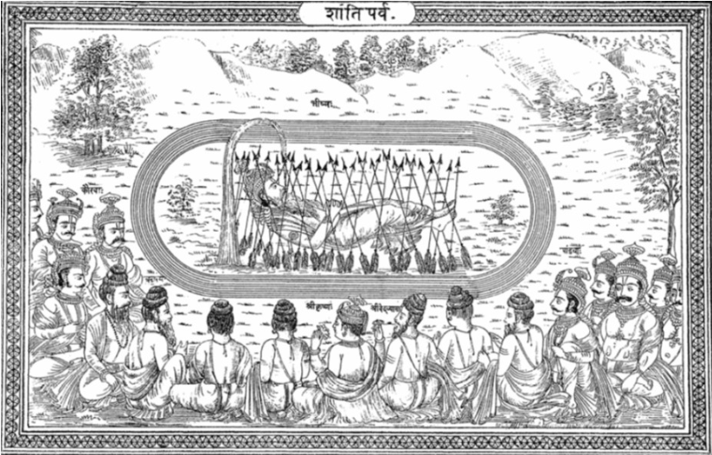
What story connects the two images?
Notes:
In this slide, there are two pictures. What is the common theme between the picture in the top and the picture in the bottom?
The picture on the top depicts what is called Matsya Nyaya. It is a state where there is no rule of law, and the big and powerful will have their way over the weak. The picture below shows the story from Mahabharata where Bheeshma is lying on a bed of arrows. The Pandavas have won the war, and Bheeshma is waiting for Uttarayana Punya Kaala to give up his life. Pandavas are doing a Ask-me-anything session with Bheeshma. Pandavas ask questions on morality, virtues, statecraft and Bheeshma is sharing his wisdom with them. This is covered in the Shanti Parva of Mahabharata. Here, Bheeshma says that in the beginning, the society was in this state of Matsya Nyaya. There was no rule of law and the powerful were free to rob / steal from weaker people. People were never happy because they were always living in this feeling of insecurity. They were afraid that any time any one can come and take away their wealth. This also meant there was no incentive for entrepreneurship, because you don’t want to work hard and make wealth if you are afraid that can be snatched any time.
People them went and appealed to Brahma and prayed to him to give a solution. And that is how dharma and rajya came into being. Dharma is basically the law, the rules and rajya is the state that was given the power of law enforcement.
The reason this story is relevant in cyber security is because in the cyber world we still live in this state of Matsya Nyaya. In the cyber world, law enforcement is still weak and there is really no rule of law.

Slide 6
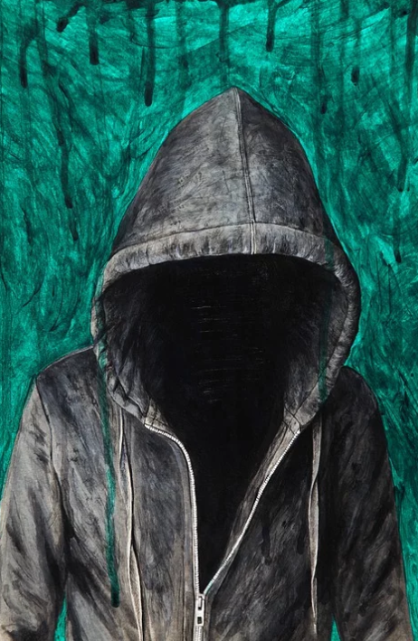
Why is it easy to commit cyber crime?
Anonymity

Slide 7
Why is it easy to commit cyber crime?
IaaS
PaaS
SaaS
CcaaS
Anonymity
Crumbling barriers

Slide 8

Why is it easy to commit cyber crime?
Anonymity
Crumbling barriers
Lack of jurisdiction

Slide 9

Why is it easy to commit cyber crime?
Anonymity
Crumbling barriers
Lack of jurisdiction
Ease of laundering

Slide 10
Why is it easy to commit cyber crime?
Anonymity
Crumbling barriers
IaaS
PaaS
SaaS
CaaS
Lack of jurisdiction
Ease of laundering

Slide 11


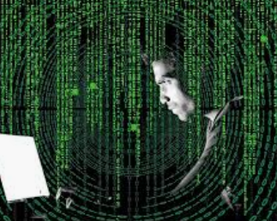
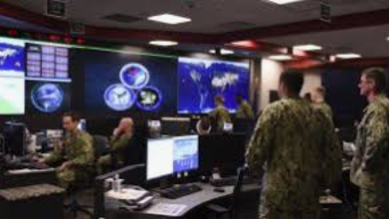
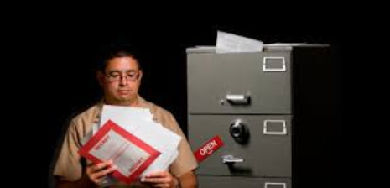
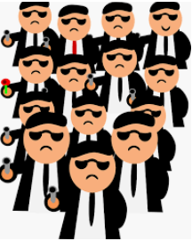
The varied threat actors…
Script kiddies
Hobby hackers
Hacktivists
Syndicates
Nation-state actors
Insider
Notes:
Now, let’s look at who all can be committing cyber crimes.
You have script kiddies who don’t have much technology knowledge but use open source tools to carry out cyber crimes.
Then you have hobby hackers who carry out hacking just for the kicks they get out of it.
You have hactivists who carry out cyber attacks driven by a mission and an ideology. You must have heard of the Anonymous group which was one such hacktivist group.
Then you have insiders who misuse their access to commit cyber crime. Like Edward Snowden who leaked thousands of NSA documents misuing his access.
Then you have organised crime syndicates who are generally termed APT groups who carry out sophisticated cyber attacks.
And of course, you have cyber armies of many nations who work for the country to carry out cyber attacks to support the tactical and strategic objectives of the country.

Slide 12
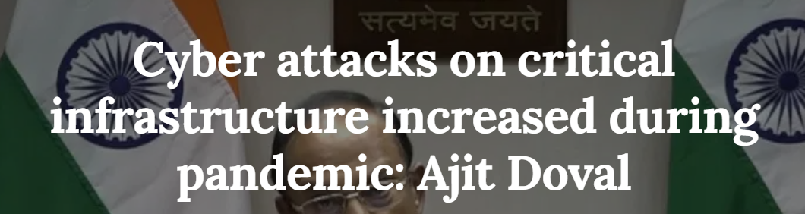
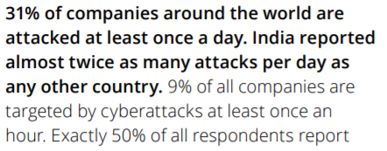

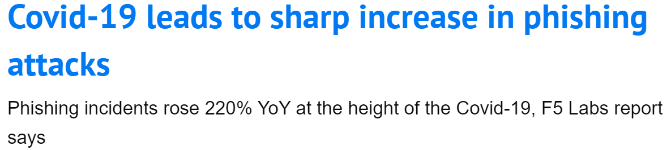
Cybersecurity during Covid19

Slide 13
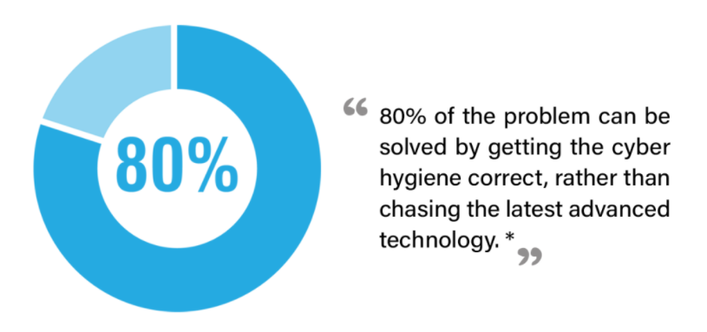
Importance of cyber hygiene
Source- cyber-observer.com

Slide 14
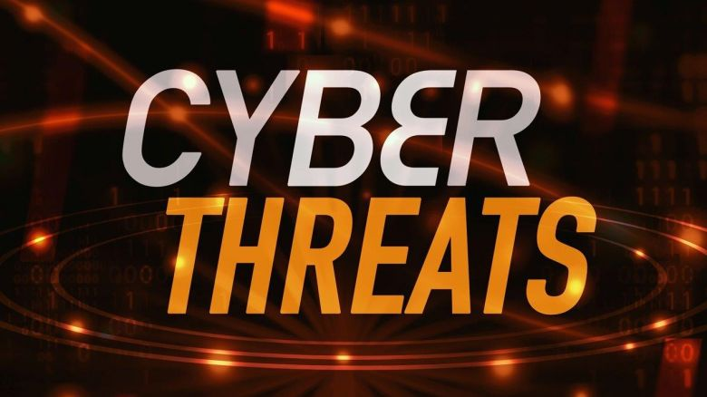
Cyber hygiene practices

Slide 15
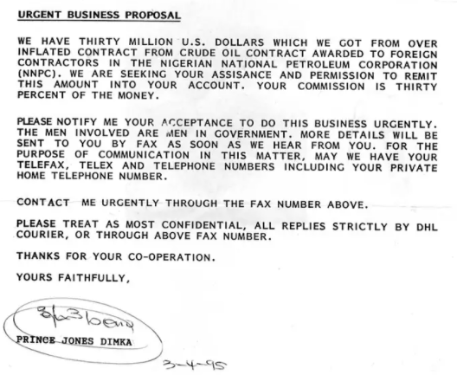
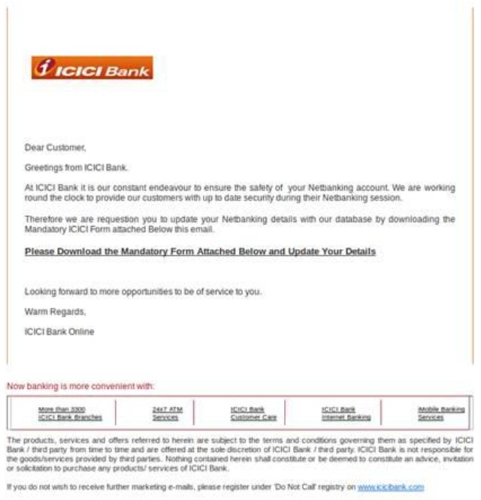
Phishing
Pre-email era
Email era

Slide 16
Phishing identification cheat sheet
Did you expect this?
Are there spelling / grammatical mistakes
Observe the email id – both displayed as well as actual email id
Do not trust URL text; see the URL carefully by hovering over
Do not click on the URL; login to the legitimate site directly
Do not go by look and feel
Check full URL of shortened URLs
Be wary of unsolicited attachments
Is it trying to bait you with urgency?
http://www.karnataka.gov.in/

Slide 17

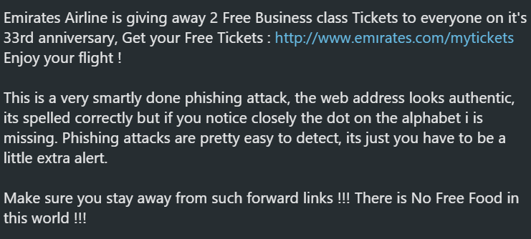
Case Study
You receive this message on WhatsApp.

Slide 18
Click Email Links with caution
Examples of when to click
You just ordered something from Flipkart. Feel free to click the shipment tracking link in the email they send you. Just make sure it’s exactly what you’re expecting. If you get a tracking link that you weren’t expecting, or for a product you don’t recognize, delete the email right away.
You just signed up for an account on a website. If they send you a link to confirm your email address, it’s okay to click it. But again, make sure it’s exactly what you’re expecting, and you remember requesting it.
Examples of when NOT to click
You get an unexpected email from your Organization. Maybe it says that you need to log in and take care of something important. Don’t click the link they give you. If you didn’t know it was coming, there’s no guarantee it’s a legitimate email.
Your friend sends you a link that you weren’t expecting. Don’t click it. Remember, the sender’s address can be spoofed or their account hacked. Yeah, I know, this is all awfully annoying, so is there anything else we can do?

Slide 19
Other types of phishing attacks
Vishing
Voice phishing
Smishing
SMS phishing

Slide 20

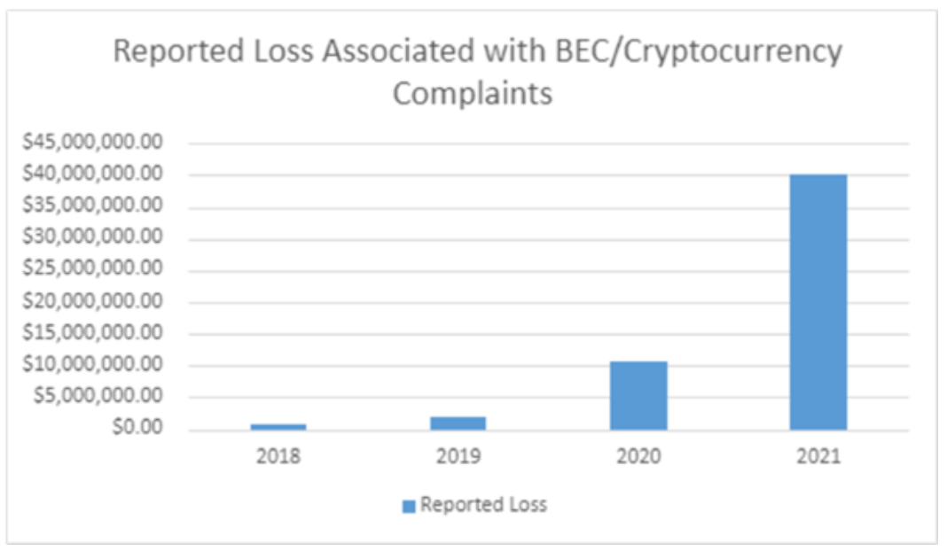
Spear phishing / Business Email Compromise
Targeted phishing attack!

Slide 21
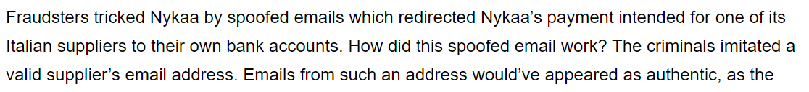

Slide 22
Whaling
Whaling is also a type of phishing attack where a high-profile target is attacked.
The objective of whaling?
  Target a senior person in the organisation
  Get money transferred by masquerading as the senior person
  Steal sensitive information like intellectual property

Slide 23
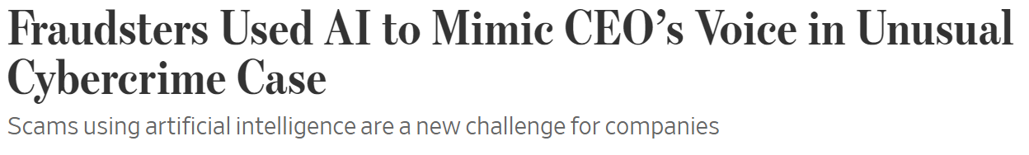
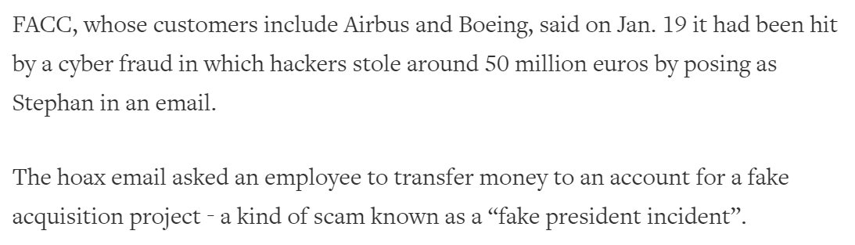


Slide 24
Socially Engineered attacks
Socially Engineered Attacks aim at taking advantage of human trust and using psychological manipulation to deceive users to gain access to sensitive information or to conduct fraud.
Stages in a socially engineered attack
Select victim
Research victim
Develop trust
Exploit trust

Slide 25
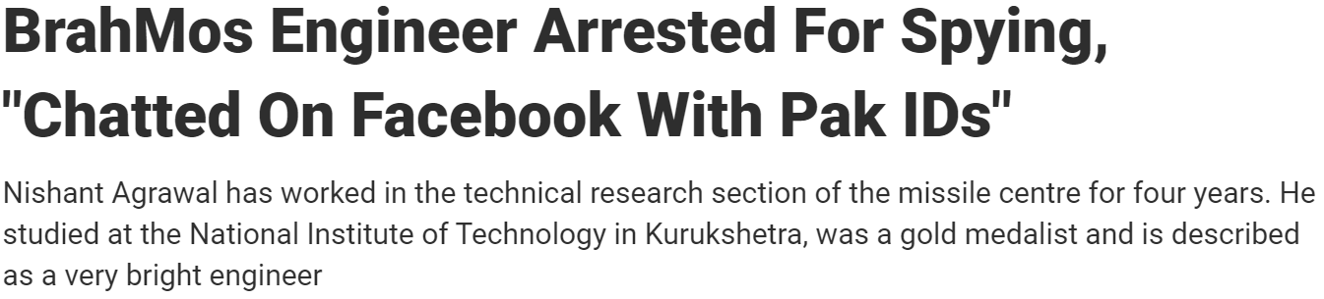
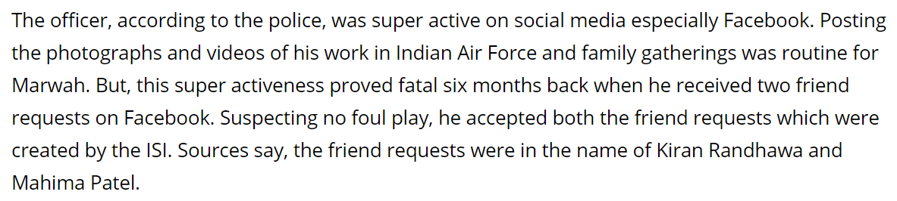
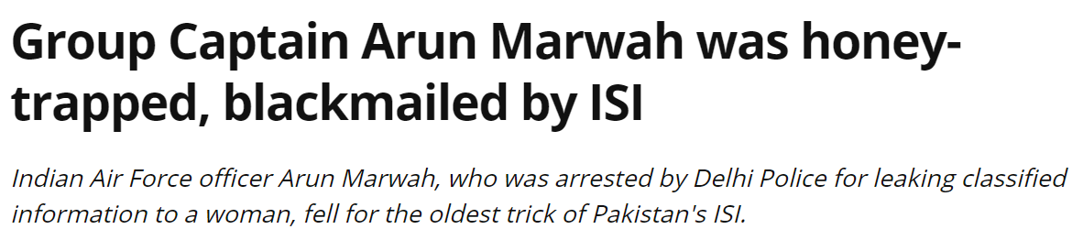

Slide 26
Fake customer service numbers
When customers search on Google, they end up calling the fraudster’s number
Trick customers to share OTPs or install remote access apps
Fraudsters look for popular, but unclaimed businesses on Google
Create fake pages on Facebook
Create fake handles on Twitter

Slide 27
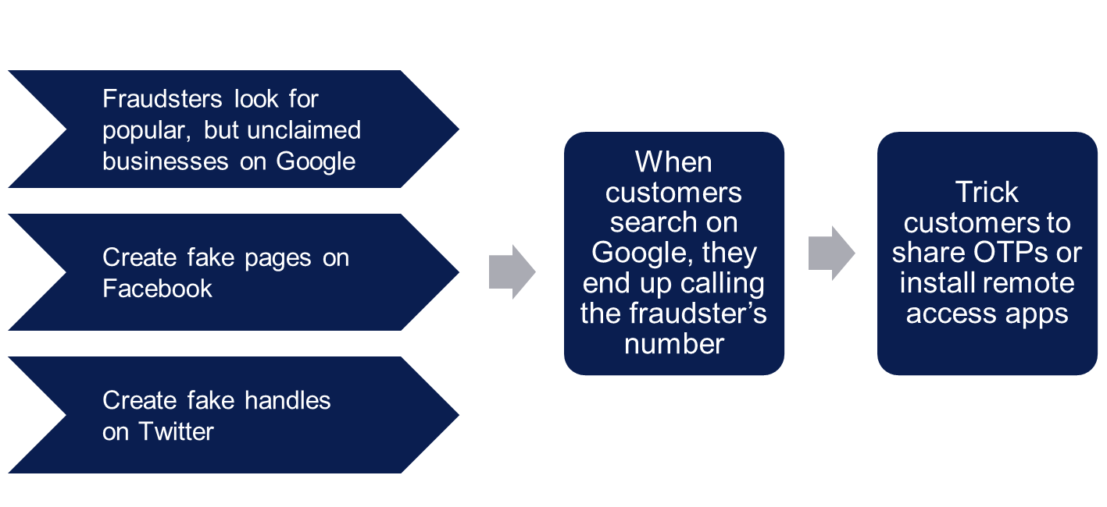
Fake customer service numbers
Tips
Obtain the number from verified websites
If in social media, look for how old the profile is and any review comments
Disconnect if anything suspicious like sharing OTPs, installing apps, etc

Slide 28
Matrimonial / romance scams
Create fake profiles on matrimonial / dating apps and websites
Build trust over a period of time
Provide excuses for emergency / taking money
Gifts sent from broad and held at customs
Emergency hospitalisations

Slide 29
Matrimonial / romance scams – Red flags
Are not willing to show their face / reluctant to come on video chat / reluctant to meet in person
Ask for a money transfer, citing some emergency, initially a small sum and later a large amount
May not have a social profile or have few friends on social media
Hesitate to share family/ workplace details
Express "love" too quickly even before fully understanding each other
The profile looks too good to be true for that person to express interest in you
Request for deletion of your profile immediately after getting in touch with you
Come up with false stories to gain sympathy

Slide 30
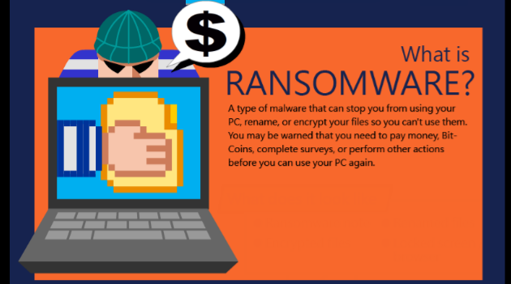
Ransomware

Slide 31
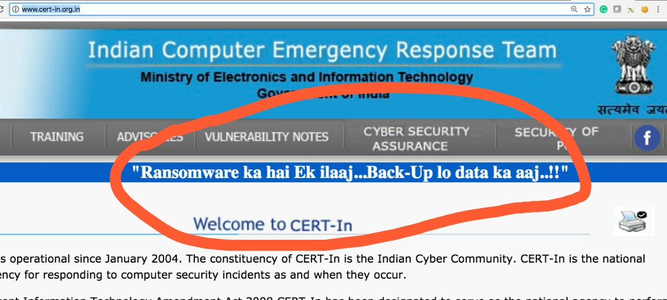
Prevention
Keep anti-virus on your machine always running and updated
Do regular backups – and make sure those have added protection or are stored offline
Be wary of unexpected emails especially if they contain links and/or attachments
Users should be especially careful of any Microsoft Office email attachment that advises enabling macros to view content

Slide 32

Cyber hygiene practices

Slide 33
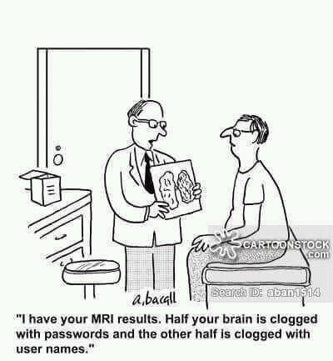
Secure Passwords

Slide 34
How hackers gain access to your passwords?
Password guessing-
Don’t be predictable. Resist the urge make passwords based on name of family / friends, birthdays, anniversaries, pet name, etc.
Shoulder surfing-
Watch out when entering password in presence of others. Do not be embarrassed to ask to step back.
Keyloggers and other malware
Keep your computer virus-free.
Brute Force – Full frontal attack
  Create long, complex, unique passwords.
Access to written passwords
  Keep your passwords in your head or encrypted on your computer
Phishing – Dangling the tasty bait
  Don’t bite the bait. Don’t ever click on links in emails or pop-ups that say they need you to log in somewhere, even if they say it’s an emergency.
Hacking password databases
  Do not reuse passwords

Slide 35


Password Security
Don’t give out your passwords: if someone else knows your password, then it’s no longer under your control
  It was Benjamin Franklin who said, “Three may keep a secret, if two of them are dead.”
Don’t reuse important passwords
Don’t write them down
Don’t create passwords based on personal information like name, date of birth,
Address, etc
DON’Ts
DOs
Use a reliable password manager
OR
Develop a method for password creation

Slide 36
Method for password creation
Jo Jo Laali Naa Haaduve Chinna Ninna Muddaduve
JJLNHCNM
$JLNHC1m
Instagram
HDFC Bank
Paytm
$JLNHI1m
$JLNHH1m
$JLNHP1m

Slide 37
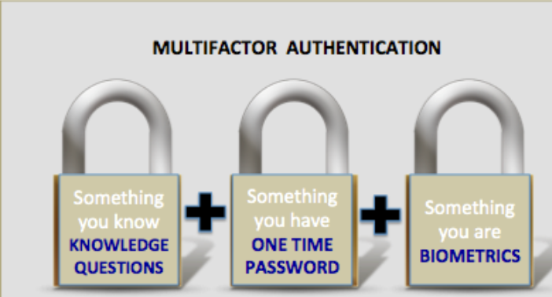
Multi Factor Authentication

Slide 38

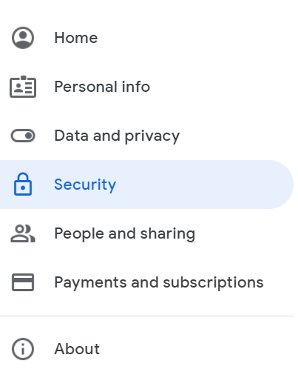
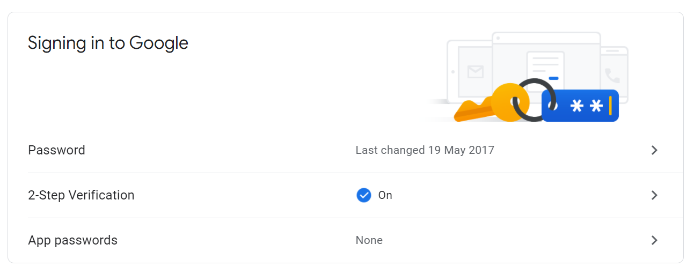
How to enable MFA? – Gmail

Slide 39

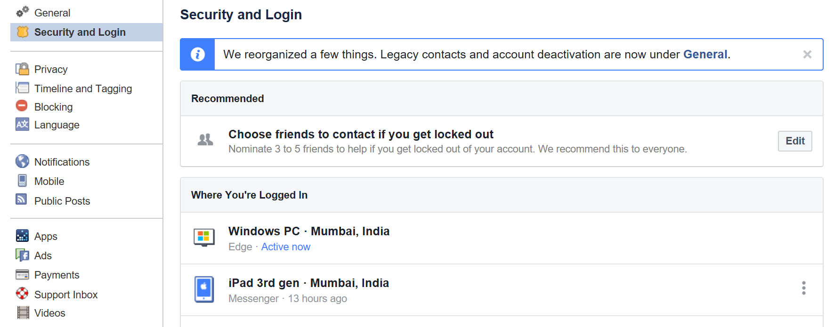
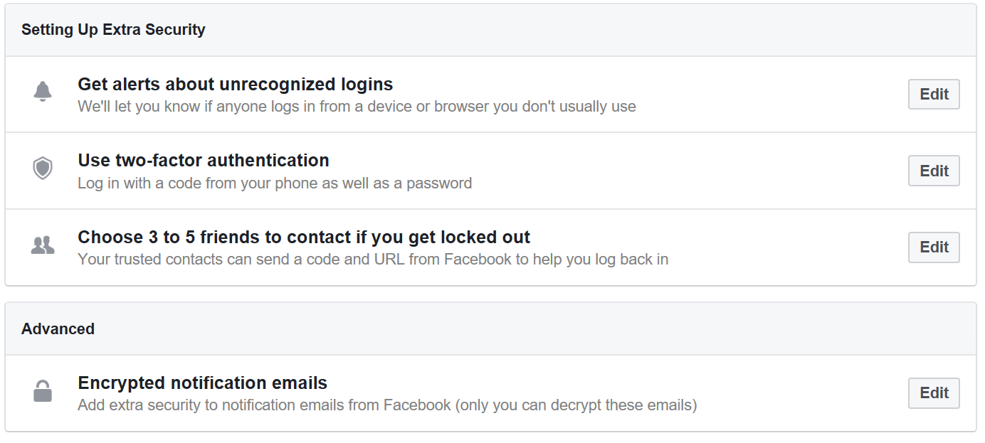
How to enable MFA? - Facebook

Slide 40
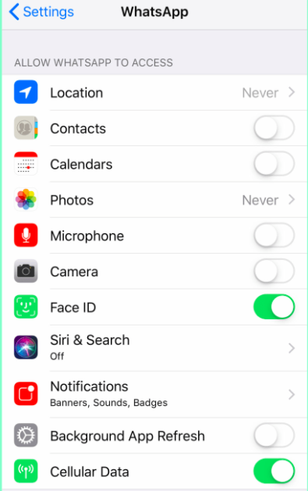
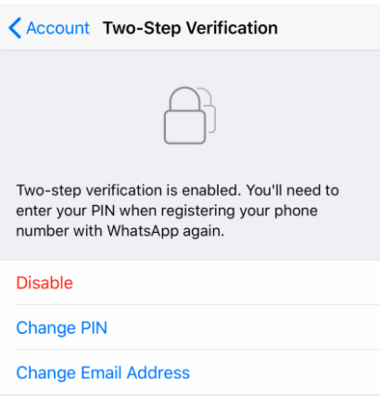
MFA on WhatsApp

Slide 41
User best practices
Careful when downloading files from internet
Install programs only from trusted sources
Avoid usage of unknown USB drives
Keep all software updated
Lock your system when not in use

Slide 42
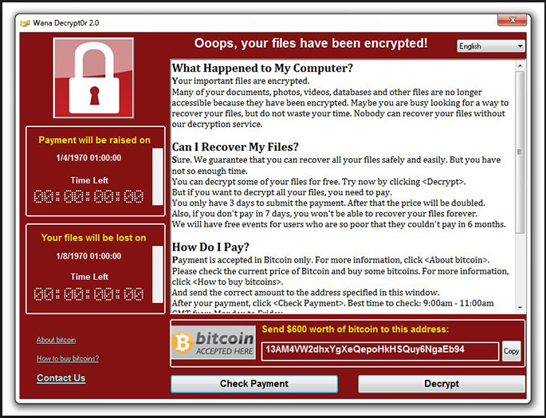


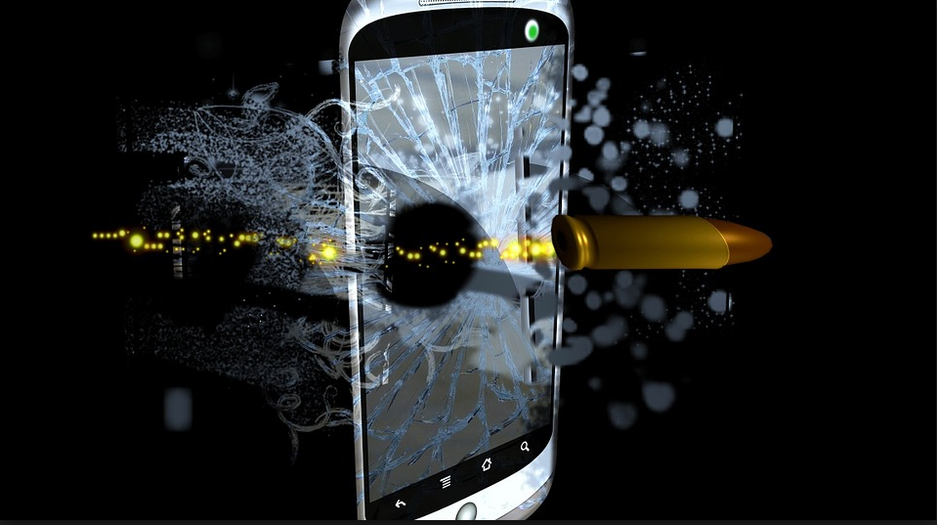
Ensure regular backups
Ransomware
To obtain protection from…
Data corruption
Device damage / loss / theft

Slide 43
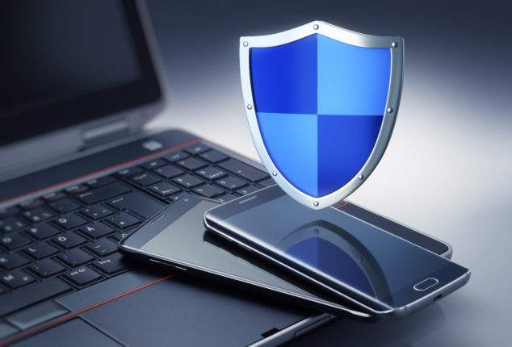
Mobile security risks
Inadequate OR poor OS patching
No PIN or Password protection
Malicious / shortened URLs
Poor WiFi / Hotspot passwords
Jailbroken Or Rooted devices
Juice jacking – attack through public USB charging points
Fraudulent public Wi-Fi access points

Slide 44

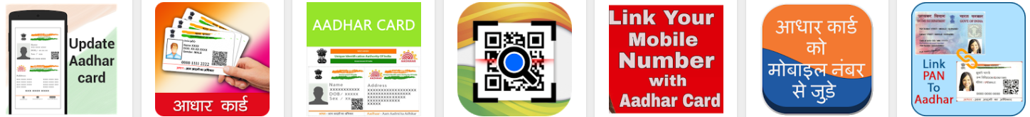
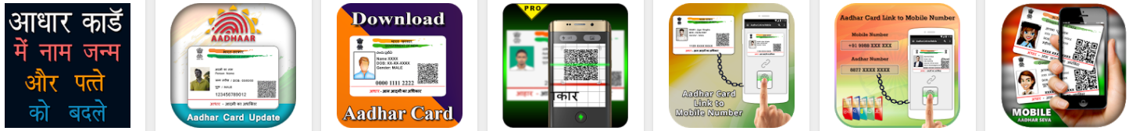
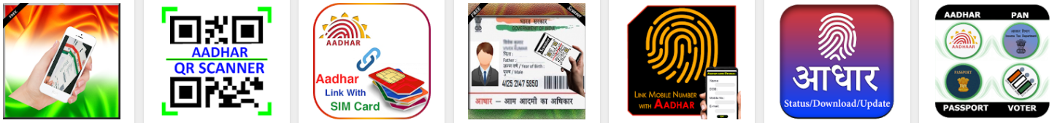
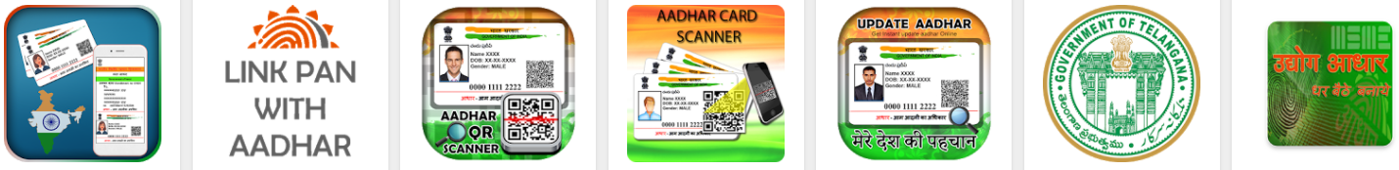
Be careful about what apps you install
Install from trusted app store
Install from the original organisation
Look for review ratings / comments

Slide 45
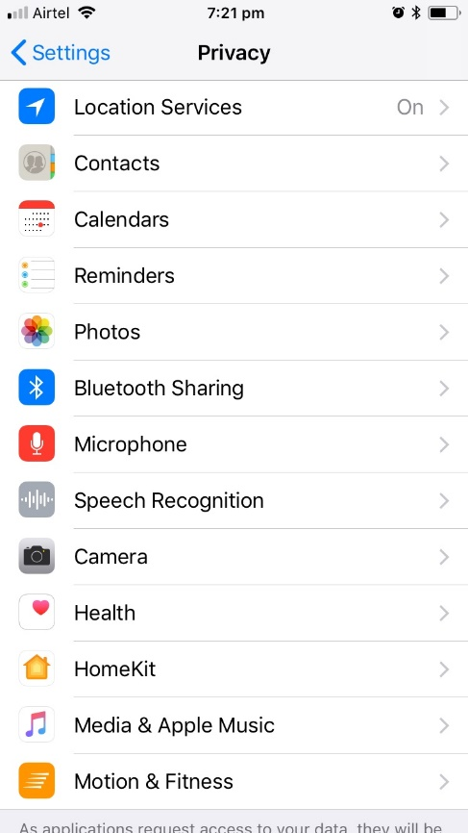
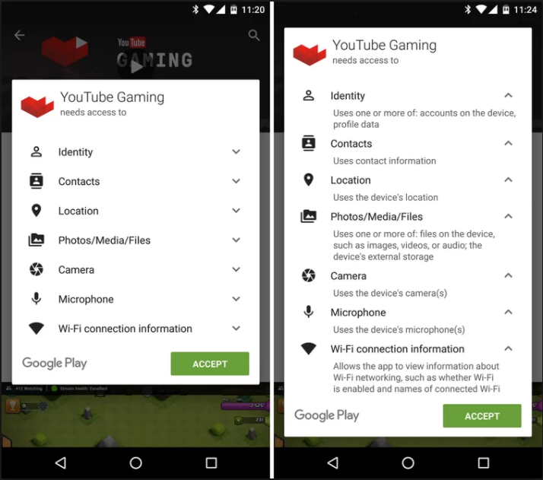
Careful about already installed apps

Slide 46

Share minimum data on social media
Careful with PII and social data -
  Date of birth
  Living address
  Phone number
  Email address
  Vacation plans
Websites that want you to sign in with your social networking accounts are only mining you for advertising potential
Reasons Why Linking Sites Is a Bad Idea
  Decreased security
  Decreased privacy
  Decreased professional reputation

Slide 47

Online Shopping
Investigate credibility - Be wary of fraud websites; they are promoted using digital marketing and SEO
Investigate free offers / high discounts
Websites asking for refundable payments
If something is too good to be true, it is probably not true!

Slide 48


Slide 49
Responsible use of technology
Digital citizenship is about responsible use of technology
Value privacy
Be sceptical
Be civil
Keep yourself updated
Do not fall for distractions
Avoid information overload
Report bad behaviour

Slide 50
Responsible use of technology
Value privacy
Be sceptical
Be civil
Keep yourself updated
Do not fall for distractions
Avoid information overload
Report bad behaviour
Be aware | Be careful | Be updated | Be wary
Know what is personal data Name, address, date of birth Aadhar number, PAN, Passport number, Driving license number, etc Medical or financial data Biometric data | When sharing personal data How securely do they handle it? Will they share with anyone else? | Follow those who study privacy policies and explain in simple terms Take privacy related news seriously | Automated recommendations Keep an open mind Follow accounts providing differing views Be always in pursuit of truth

Slide 51
Responsible use of technology
Value privacy
Be sceptical
Be civil
Keep yourself updated
Do not fall for distractions
Avoid information overload
Report bad behaviour
Do not trust easily
Remember that anonymity is easy in the cyber space
Anybody can publish anything. Everything published need not be true.
Verify authenticity before sharing information.

Slide 52
Responsible use of technology
Value privacy
Be sceptical
Be civil
Keep yourself updated
Do not fall for distractions
Avoid information overload
Report bad behaviour
Maintain good citizenship practices in cyber world as well
Be civil when interacting with others
Do not let remoteness and anonymity bring out negativity

Slide 53
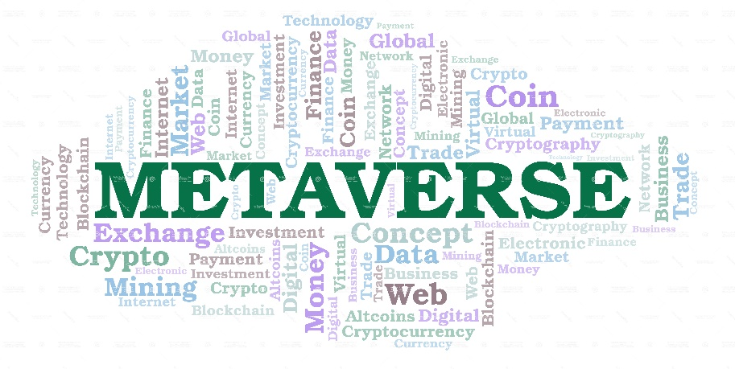
Responsible use of technology
Value privacy
Be sceptical
Be civil
Keep yourself updated
Do not fall for distractions
Avoid information overload
Report bad behaviour
Technology is changing dynamically.
If we don’t keep ourselves updated, we will get left behind.
Fraudsters are always looking for new ways to cheat.
Don’t just update yourself; update your devices!

Slide 54
Responsible use of technology
Value privacy
Be sceptical
Be civil
Keep yourself updated
Do not fall for distractions
Avoid information overload
Report bad behaviour
Cyber world runs on clickbaits!
Big tech also want you to be glued in all the time.
Infinite scrolling content
Easy to access inappropriate content

Slide 55
Responsible use of technology
Value privacy
Be sceptical
Be civil
Keep yourself updated
Do not fall for distractions
Avoid information overload
Report bad behaviour
The world contains far more information than any single person can learn in their lifetime.
The question is not whether you are ignorant, but what you choose to be ignorant about.
Few topics are worth your precious time. Choose what you pay attention to with great care.
- James Clear

Slide 56
Responsible use of technology
Value privacy
Be sceptical
Be civil
Keep yourself updated
Do not fall for distractions
Avoid information overload
Report bad behaviour
The greatest tragedy is not the strident clamor of the bad people, but the appalling silence of the good people.
- Martin Luther King Jr

Slide 57
How to report?
Report on the platform
Report to government agencies
Twitter
Instagram
WhatsApp
Report on
cybercrime.gov.in
Ministry of Women & Child Development
Email:
complaint-mwcd@gov.in
Karnataka
Call 112
Facebook
Pinterest
Discord
Profiles
Allows even anonymous reporting
Sexual abuse towards women / children
Can file Cyber Crime Incident Report
Posts
DMs

Slide 58
About CySecK’s Volunteer Programme

Slide 59
Expectations and incentives
Expectations
Incentives
Honorarium of Rs.3k for sessions at your district of residence.
Honorarium of Rs.5k for sessions outside of your district of residence.
Inform us before the session.
Share email ids of participants after the session.
Share 4-5 good quality photographs of the event.
If posting on social media, do tag the CySecK accounts.
Use the standard presentation as much as possible. Any changes to the standard presentation must be informed to CySecK.
Encourage participants to follow CySecK on social media.
Reach out to the community and conduct sessions across various for a – schools / colleges / clubs / elders associations / resident associations, etc

Slide 60

Thank you

