Slide 1
Cyber forensics principles
Jayaram P
CDAC

Slide 2
Plan
Cyber Crime
Cyber Forensics Steps
Live Forensics

Slide 4
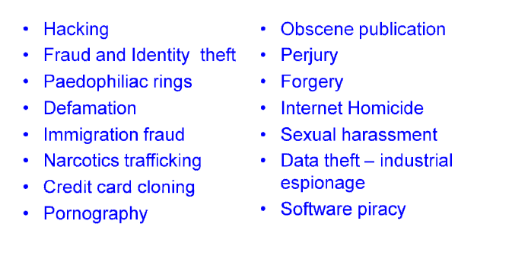
Notes:
Perjury - the offence of wilfully telling an untruth or making a misrepresentation under oath.
Internet homicide- refers to killing in which victim and perpetrator met online, in some cases having known each other previously only through the Internet.
Ex:- Blue wale

Slide 5
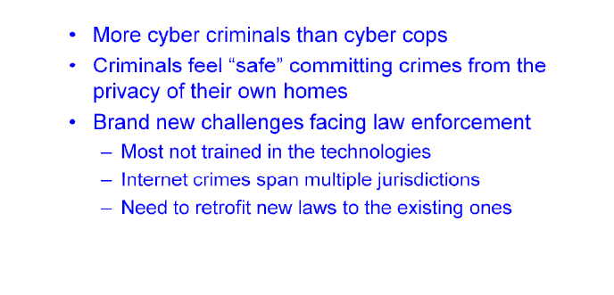
Notes:
paedophile ring - a group of people who take part in illegal sexual activity involving children

Slide 8
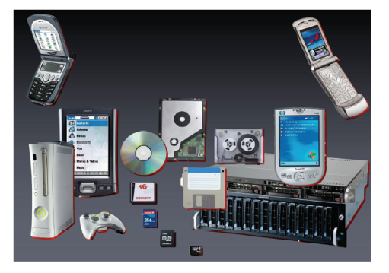

Slide 10
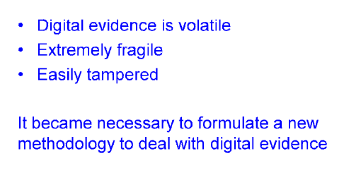

Slide 11
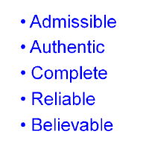
Notes:
Admissible - acceptable or valid, especially as evidence in a court of law.
Authentic - of undisputed origin and not a copy; genuine.

Slide 13
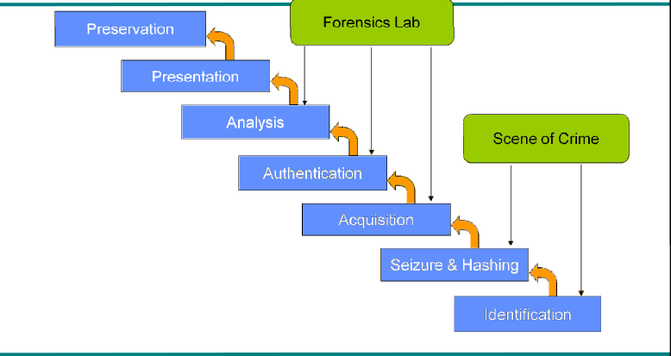

Slide 14
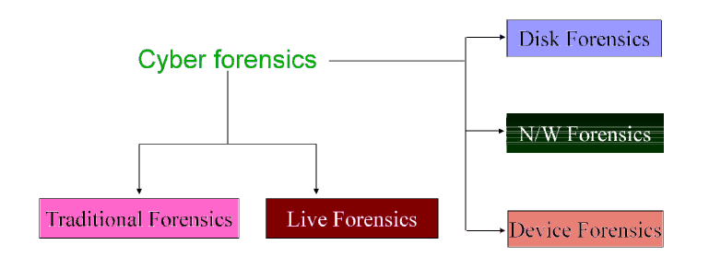

Slide 16
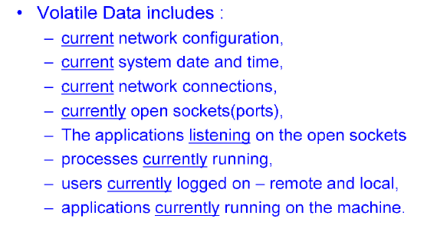

Slide 18
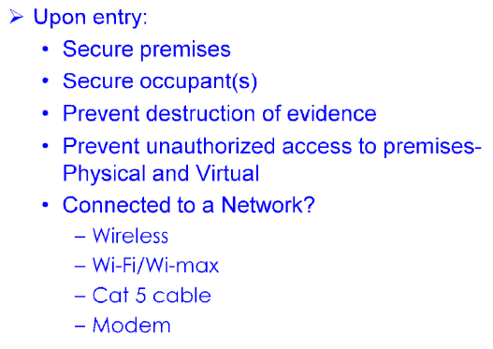

Slide 19
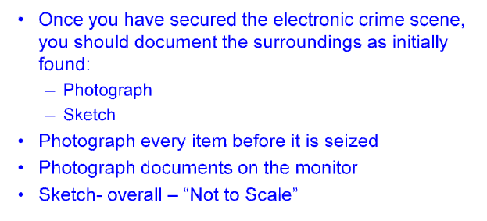

Slide 20
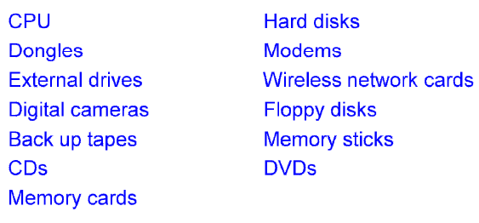

Slide 21
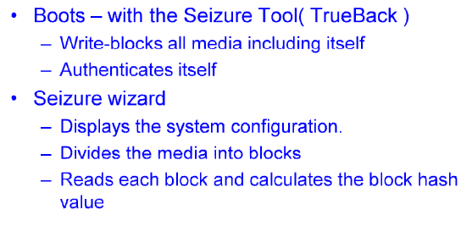

Slide 22
Notes:
IO - Incharge Officer.

Slide 23
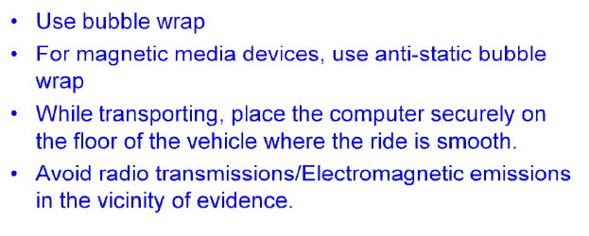

Slide 25
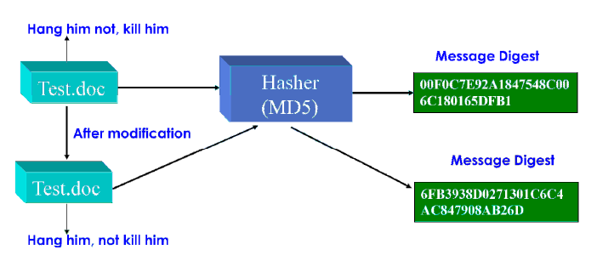

Slide 26
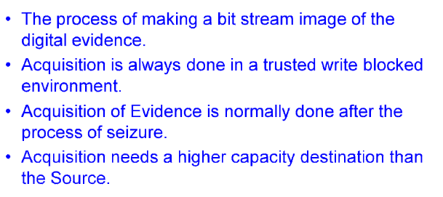

Slide 28
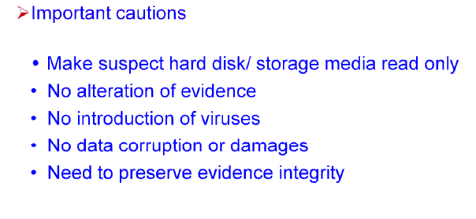

Slide 29
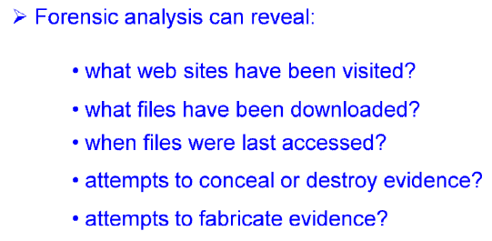

Slide 30
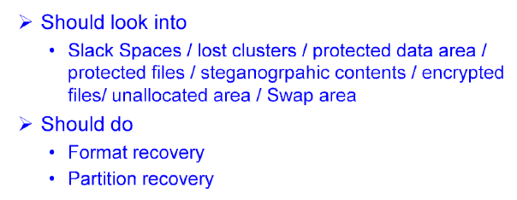

Slide 32
Live Forensics

Slide 33
Live Forensics - Challenges
Need access to the system
Minimize impact on system.
Some tools leave footprint and hence proper audit/notes to be made.
Timely evidence acquisition and analysis.

Slide 34
Conducting Live Forensics
Retrieval of volatile data
Forensic imaging of live system
Analysis of evidence collected

Slide 35
Scenario : Ongoing Crime
Want to catch them “in the act”
See how things change (web pages, file access times, registry, memory, etc.)
Want to understand:
How they got in
What they compromised
Where they are
Who they are

Slide 36
Live Data
System time
Logged-on user(s)
Open files
Network information
Network connections
Process information
Process-to-port mapping
Process memory
Network status
Clipboard contents
Service/driver information
Command history
Mapped drives
Shares

Slide 37
Non-volatile Data
Event logs
Registry
Disks

Slide 38
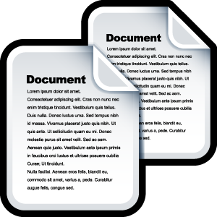
Memory Analysis
Memory Acquisition
Perform Ram Dump to a file [Using Tools like DumpIt, mdd etc]
Dump file
Dump File Analysis
Report Generation
Dump file
Analyzed using tools (eg.Volatility , Win-LiFT)

Slide 39
Live Forensics Tools

Slide 40
C-DAC’s Win-LiFT
COFEE(Computer Online Forensic Evidence Extractor )
EnCase Portable

Slide 41
https://cyberforensics.in/

Slide 42
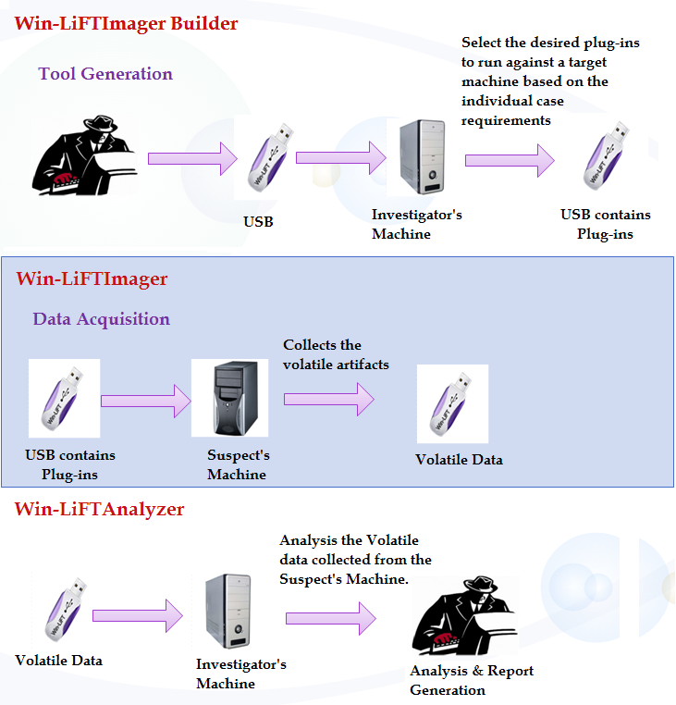
Investigator’s Machine
Suspect’s Machine
Investigator’s Machine

Slide 43
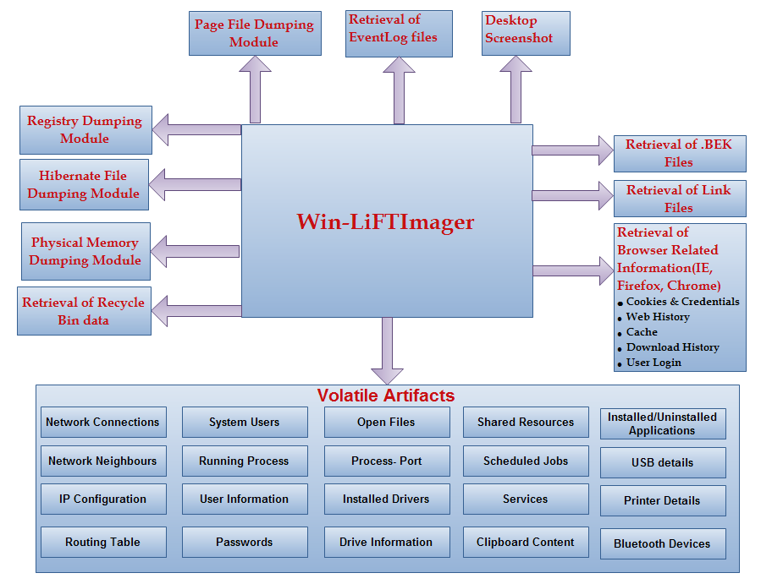

Slide 44
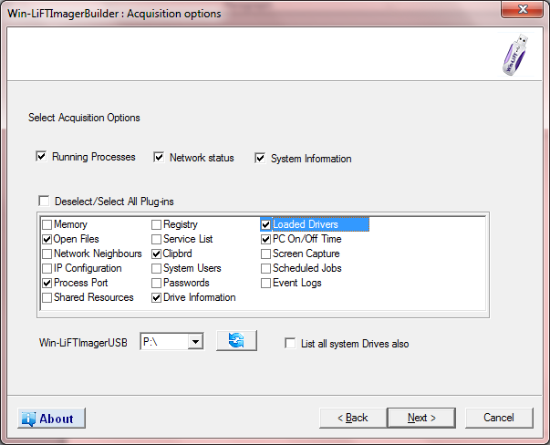

Slide 45
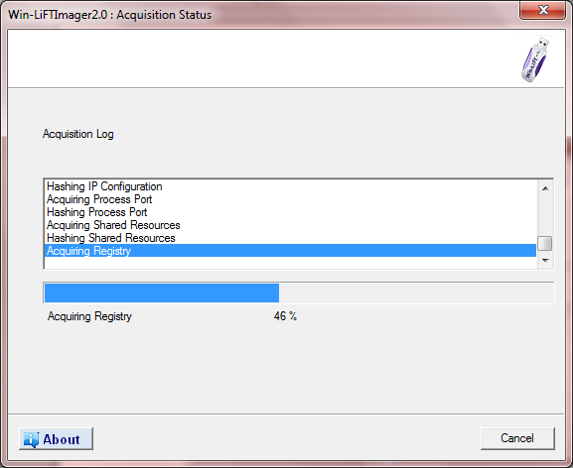

Slide 46
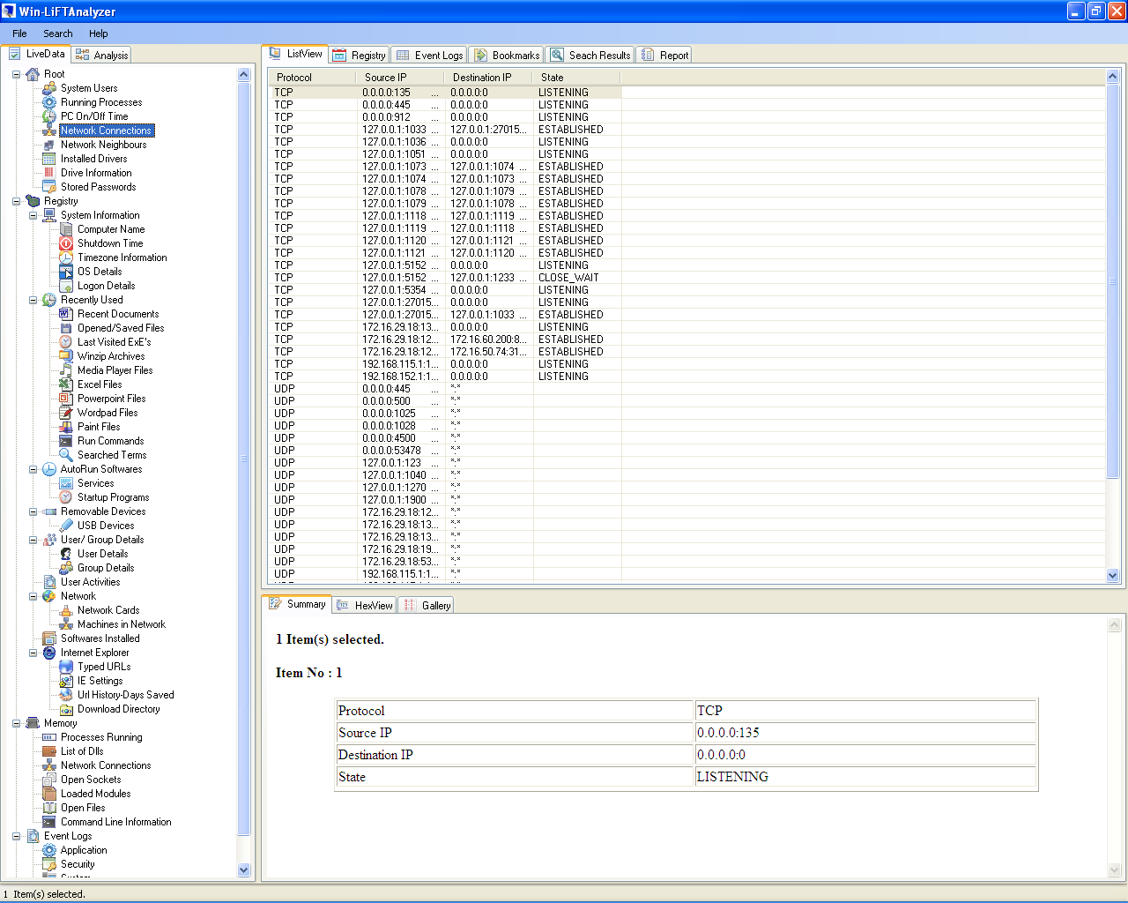

Slide 47
Live Forensic Tools - COFEE

Slide 48
Easy to use
Capture important "live" computer evidence
Special forensics expertise not needed.
Computer Online Forensics Evidence Extractor

Slide 49
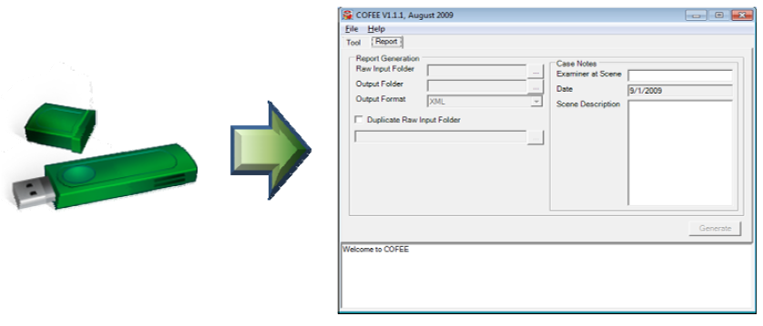
Computer Online Forensics Evidence Extractor

Slide 50
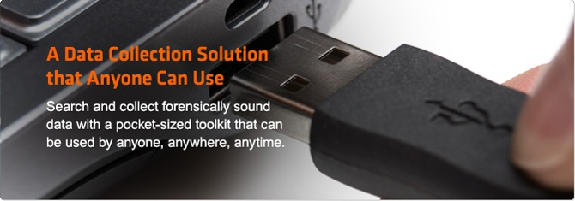
Live Forensic Tools - Encase Portable
Easy to Use
Forensically Sound
Ultra-Portable
Stealth

Slide 51
Forensic Tools in Kali Linux

Slide 52
More than 200 penetration testing tools are packaged in Kali Linux.
More than 20 tools for forensics packaged inside Kali Linux.
Binwalk tool:
searches a specified binary image for executable code and files.
Bulk extractor tool:
Extracts credit card numbers, URL links, email addresses etc..
Works on compressed data and incomplete or damaged data.
HashDeep tool:
For hashing of files.
Magic rescue tool:
Performs scanning operations on a blocked device.
Recovers files deleted or from corrupted partition.
Guymager tool:
Used to acquire media for forensic imagery

Slide 53
Pdfid tool:
Scans pdf files for specific keywords.
7. Pdf-parser tool:
8. Peepdf tool:
9. Autopsy tool:
An autopsy is all in one forensic utility for fast data recovery and hash filtering.
This tool carves deleted files and media from unallocated space.
10. img_cat tool:

Slide 54
Thank You
jayaram@cdac.in

