Slide 1
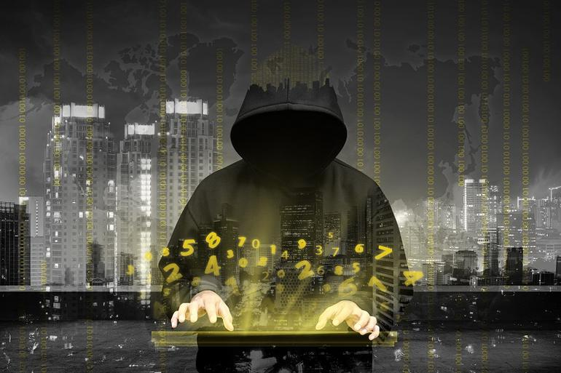
Emerging Cyber Attacks & Mitigation Techniques
Rekha R
- Researcher SETS

Slide 2
Contents
Introduction to Cyber Attacks
How Cyber Attacks work?
Cyber Attack Types
Mitigation Techniques

Slide 3
Cyber Security - Cyber Attack
What is Cyber Security ?
Cyber security is a practice which intends to protect computers, networks, programs and data from unintended or unauthorised access, change or destruction
What is Cyber Attack ?
An attempt by hackers to damage or destroy a computer network or system.

Slide 4
Cyber Attacks - History
Morris Worm - 1988 - $100 million
Teen hacks - NASA & US Defense - 1999- $41,000
The Mellissa Virus - 1999 - $80 million
Mafia Boy - 2000 - $1 billion
Internet attacked - 2002 - 13 DNS root servers - DDOS attack lasted for 1 hour
Hacker steals tens of million of credit card details - 2009
Recent Past
Twitter: 32 Million
Yahoo: 500 Million (LinkedIn, Amazon, Facebook, Credit Cards, )
Security cameras, breachable appliances, access control systems
Malware found on all platforms including Apple
2 million new signatures of malware

Slide 5
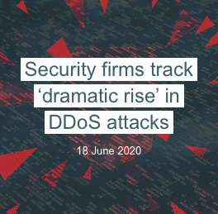
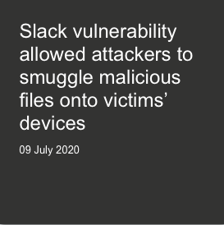
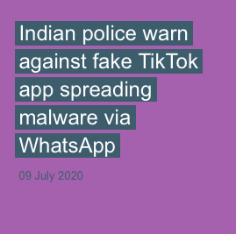
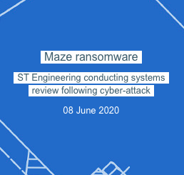
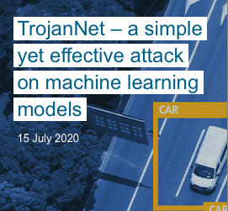
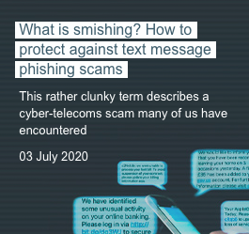
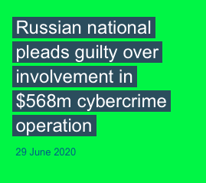

Slide 6
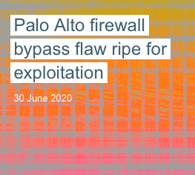
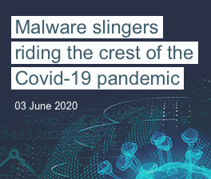
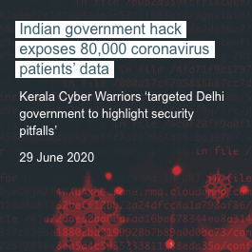
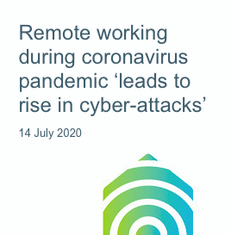
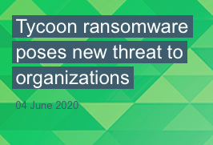
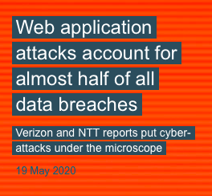
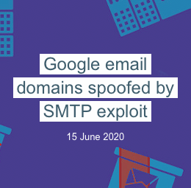
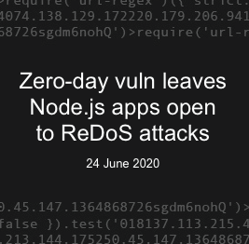
Source: https://portswigger.net/daily-swig/cyber-attacks

Slide 7
Recent Cyber Attacks in India
India - second most affected country due to Cyber Attacks
Cosmos Bank Cyber-Attack in Pune - Rs.94.42 crore
ATM System Hacked
Hack Attack on Indian Health care Websites - 68 Lakh patients record
SIM swap scam - Rs.4 crore
40,000 cyber-attacks attempted by chinese hackers on Indian banking, IT sector in five days - Jun 24,2020 - Maharashtra Cyber cell
Source: http://newsonair.com/Main-News-Details.aspx?id=392081
https://www.ndtv.com/india-news/rise-in-cyber-attacks-from-china-over-40-000-cases-in-5-days-official-2251111

Slide 8
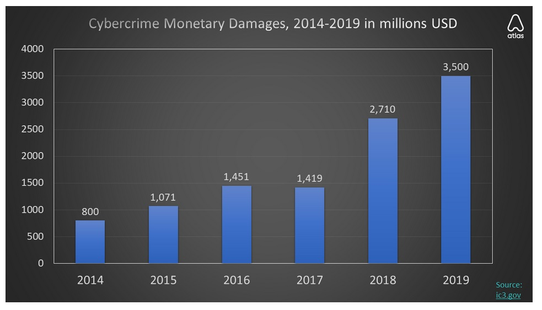
Cybercrime damages increased by 338% in the last 6 years

Slide 9
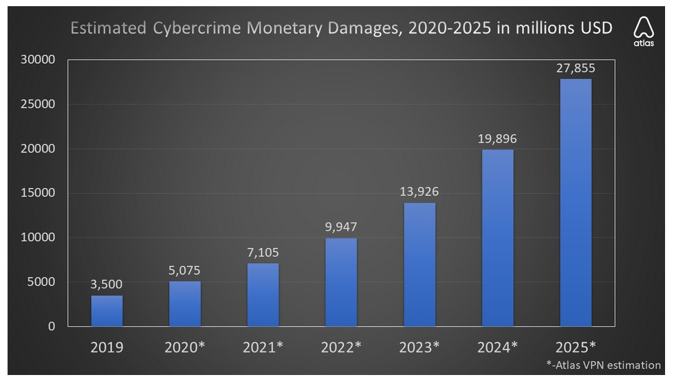
Cyber attacks - Cost Predictions by 2025

Slide 10
Cyber Attackers - Who they are ?
Cyber criminals interested in making money through fraud or from the sale of valuable information.
Hackers who find interfering with computer systems enjoyable
Hacktivists who wish to attack enterprise/organization for political or ideological motives
Industrial competitors and foreign intelligent services, interested in gaining an economic advantage for their companies or countries
Employees, or those who have legitimate access, either by accidental or deliberate misuse.

Slide 11
Key Point
You have no control over their capabilities and motivations, but you can make it harder for attackers by reducing your vulnerabilities

Slide 12
Understanding Vulnerabilities
A vulnerability is a weakness which can be exploited by an attacker, to perform unauthorized actions within a computer system
Flaws
Features
User Error

Slide 13
Vulnerabilities from Flaws
A flaw is unintended functionality
The result of poor design or implementation mistakes may go undetected for some time
The majority of common attacks seen today exploit these types of vulnerabilities
Nearly 8,000 new unique and verified software vulnerabilities disclosed last year

Slide 14
Vulnerabilities from Features
Intended functionality which can be misused to breach a system
MS Office Macros
Mellisa Worm
Dridex Banking Trojan
JavaScript
Diverting the users browser
Silently downloading malicious code
Hiding malicious code from basic web filtering

Slide 15
Vulnerabilities from User Error
A system administrator who
Enables a vulnerable feature
Fails to fix a known flaw
Leaves default passwords unchanged
More generally, users can be a significant source of vulnerabilities
Commonly or easily guessed passwords
Leave laptop or mobile unattended
Fooled into disclosing password
Accidentally install malware
Divulge sensitive information
Clicking things they shouldn’t

Slide 16
Untargeted Vs Targeted Attacks
Untargeted Atttacks | Targeted Attacks
Attacker indiscriminately target as many devices, services or users as possible. | Any user or organisation is singled out
Do not care about who the victim is | Attacker may have specific interest in your business, or has been paid to target you.
Will find a number of machines or services with vulnerabilities | Ground work would take months
Less Damage | Often more damage
Example: Phishing, Watering hole, Ransomware, Scanning | Example: Spear Phishing, Deploying a botnet to deliver a DDOS attack, Supply - Chain Attack

Slide 17
How Cyber Attacks work ?
Survey
Delivery
Breach
Affect
Whether targeted or untargeted, all cyber attacks have common stages and patterns
Understanding these stages will help you better defend yourselves

Slide 18
Survey
Investigating and analysing available information about the target to identify potential vulnerabilities
Open source information: LinkedIn, Facebook, DNS, Social media
Commodity toolkits and techniques
Standard Network Scanning tools
Technical Focus: The attacker will point network scanning tools at the targeted network to try and identify
open ports
open services
default settings
vulnerable applications and operating system
the makes and models of the network equipments

Slide 19
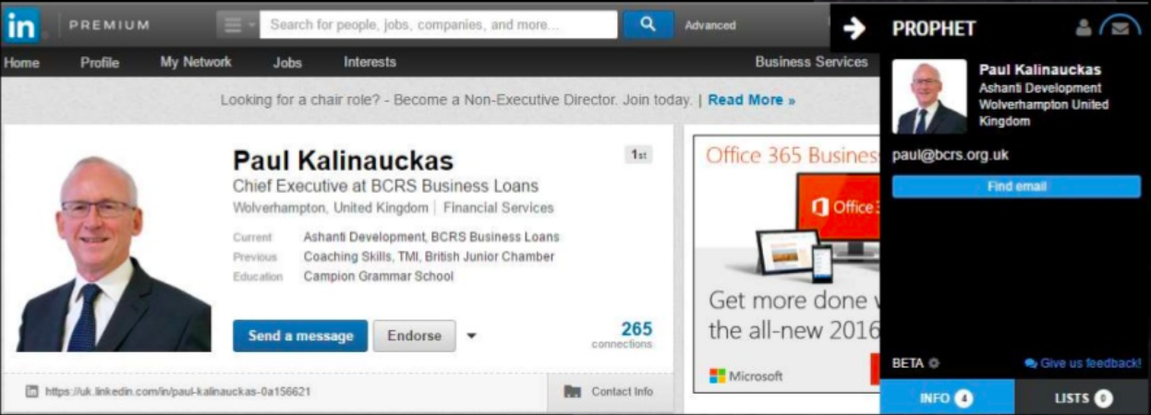
Survey via Social Media

Slide 20
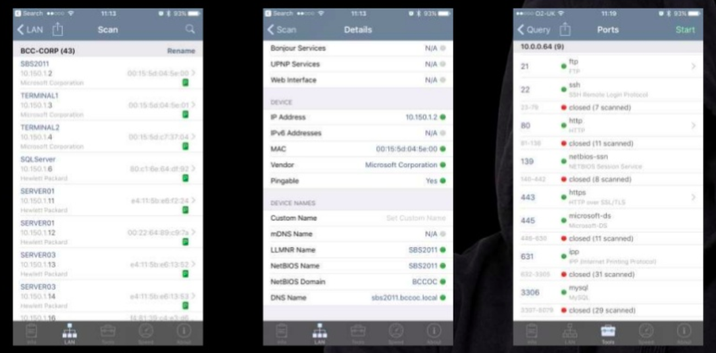
Survey via iPhone connected to WIFI

Slide 21
Delivery
Getting to the point where a system vulnerability can be exploited
Attempting to access an organisation’s online services
Sending an email containing a link to a malicious website or an attachment with malicious code
Giving away an infected USB stick
Creating a false website for the user to visit

Slide 22
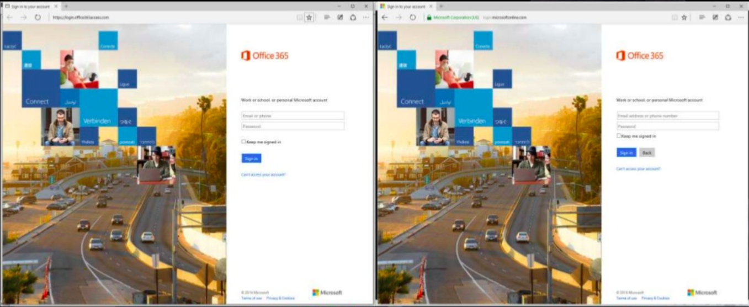
Which site is real ?

Slide 23
Breach
Exploiting the vulnerability/vulnerabilities to gain some form of unauthorised access.
Make changes that affect the system’s operation
Gain access to online accounts
Achieve full control of a user’s computer, tablet or smart phone
Technical Focus: DDOS attacks, Unique Malware design, Unfixed flaw, misused feature or user error

Slide 24
Affect
Carrying out activities within a system that achieve the attackers goal
Retrieve information they would otherwise not have access to (IP/Sensitive information)
Make changes for their own benefit (creating payments to their bank account)
Disrupt normal business operation
More capable attackers will remove evidence.
May leave an access route for future visits, or sell on the access (create noise to advertise their success)

Slide 25
Security Issues - Cyber Attacks
☺
☺
☹
☹
☠
Normal Flow
Interruption
☹
☹
☹
☹
☠
☠
Modification
Interception
☹
☹
Get it?
No!
😐
😐
☠
No!
Sent it?
Fabrication
Repudiation

Slide 26
Security Issues - Cyber Attacks
☺
☺
☹
☹
☠
Availability
Normal Flow
Interruption
☹
☹
☹
☹
Integrity
☠
☠
Confidentiality
Modification
Interception
☹
☹
Get it?
No!
😐
😐
Authenticity
☠
No!
Sent it?
Non Repudiation
Fabrication
Repudiation

Slide 27
Classification of Cyber Attacks
Web Based Attacks
These are the attacks on a website or web application
System Based Attacks
Attacks that are intended to compromise a computer or computer network

Slide 28
Classification of Cyber Attacks
Web Based Attacks
DDoS
Brute Force
Session Hijacking
Man in Middle
SQL Injection
Phishing
Watering Hole
System Based Attacks
Virus
Worms
Trojan Horse
Back Doors
Bots

Slide 29
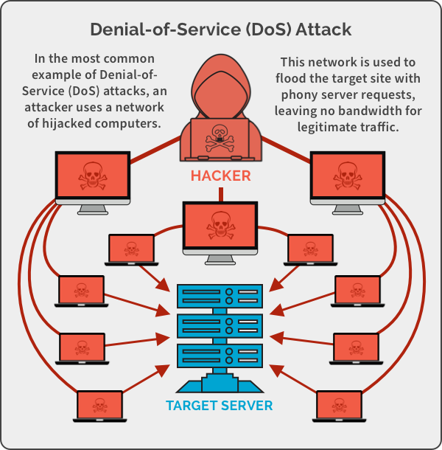

Slide 30
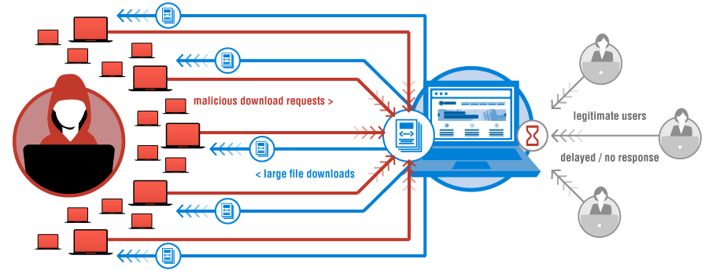
Different ways DoS can be used
Buffer Overflow attack - the attacker overloads a network address with traffic so that it is put out of use.
Ping of Death or ICMP flood - takes unconfigured or misconfigured network devices and uses them to send spoof packets to ping every computer within the target network
SYN Flood - send requests to connect to a server but don’t complete the handshake. Prevents legitimate users
TearDrop Attack -An attacker sends IP data packet fragments to a network. The network then attempts to recompile these fragments into their original packets. The process of compiling these fragments exhausts the system and it ends up crashing. It crashes because the fields are designed to confuse the system so that it can not put them back together.

Slide 31
Broad types of DDOS Attacks
Volumetric attacks - target network’s bandwidth resources are deliberately consumed by an attacker.
Fragmentation attacks - forces a network to reassemble manipulated network packets
TCP State Exhaustion attacks— the attacker targets a web server or firewall in an attempt to limit the number of connections that they can make.
Application Layer Attacks -attacks that target applications or servers in an attempt to use up resources by creating as many processes and transactions possible.

Slide 32
AI based DDOS Mitigation Techniques

Slide 33
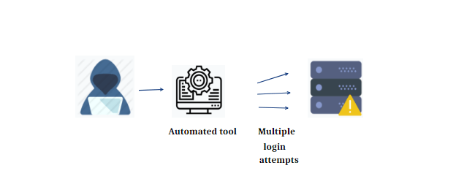
Brute Force Attacks
Notes:
As more devices become internet-enabled and accessible and the security measures in place continue to lag behind, the associated risks are on the rise. Aside from the obvious risks for attacks on consumer IoT devices, there is a growing threat against industrial and municipal IoT as well. As leading manufacturers and grid power producers transition to Industry 4.0, sufficient safeguards are lacking. Not only do these IoT devices run the risk of being used to attack others, but their vulnerabilities leave them open to being used against the industrial organizations operating critical infrastructure themselves. This can lead to theft of intellectual property, collecting competitive intelligence, and even the disruption or destruction of critical infrastructure. Not only is the potential scale of these attacks larger, most of these industrial firms do not have the skills in place to deal with web attacks in real-time, which can cause long-lasting, damaging results. This alone will become one of the greatest threats that countries and corporations need to brace themselves for in 2017 and beyond.
There are plenty of "As-A- Service" attack capabilities on the Dark Web for hire now and we should expect creative new IoT hack services to pop up in the near future.
As organizations adopt more effective strategies to defeat malware, attackers will shift their approach and start to use legitimate credentials and software - think physical insiders, credential theft, man-in-the-app. The increased targeting of social media and personal email bypasses many network defenses, like email scans and URL filters. The most dangerous aspect is how attackers manipulate victims with offers or threats that they would not want to present to an employer, like employment offers or illicit content. Defenders will begin to appreciate that inconsistent user behaviors are the most effective way to differentiate malware and insider threats from safe and acceptable content.

Slide 34
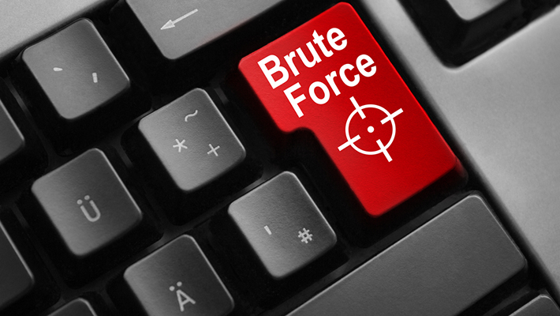
How to Defend against Brute Force Attacks
Increase password length
Increase password complexity
Limit Login Attempts
Implement Captcha
Use multi-factor authentication
Notes:
As more devices become internet-enabled and accessible and the security measures in place continue to lag behind, the associated risks are on the rise. Aside from the obvious risks for attacks on consumer IoT devices, there is a growing threat against industrial and municipal IoT as well. As leading manufacturers and grid power producers transition to Industry 4.0, sufficient safeguards are lacking. Not only do these IoT devices run the risk of being used to attack others, but their vulnerabilities leave them open to being used against the industrial organizations operating critical infrastructure themselves. This can lead to theft of intellectual property, collecting competitive intelligence, and even the disruption or destruction of critical infrastructure. Not only is the potential scale of these attacks larger, most of these industrial firms do not have the skills in place to deal with web attacks in real-time, which can cause long-lasting, damaging results. This alone will become one of the greatest threats that countries and corporations need to brace themselves for in 2017 and beyond.
There are plenty of "As-A- Service" attack capabilities on the Dark Web for hire now and we should expect creative new IoT hack services to pop up in the near future.
As organizations adopt more effective strategies to defeat malware, attackers will shift their approach and start to use legitimate credentials and software - think physical insiders, credential theft, man-in-the-app. The increased targeting of social media and personal email bypasses many network defenses, like email scans and URL filters. The most dangerous aspect is how attackers manipulate victims with offers or threats that they would not want to present to an employer, like employment offers or illicit content. Defenders will begin to appreciate that inconsistent user behaviors are the most effective way to differentiate malware and insider threats from safe and acceptable content.

Slide 35
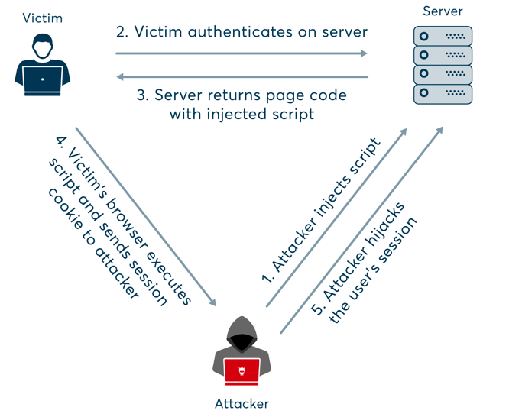
Session
Hijacking
Notes:
As more devices become internet-enabled and accessible and the security measures in place continue to lag behind, the associated risks are on the rise. Aside from the obvious risks for attacks on consumer IoT devices, there is a growing threat against industrial and municipal IoT as well. As leading manufacturers and grid power producers transition to Industry 4.0, sufficient safeguards are lacking. Not only do these IoT devices run the risk of being used to attack others, but their vulnerabilities leave them open to being used against the industrial organizations operating critical infrastructure themselves. This can lead to theft of intellectual property, collecting competitive intelligence, and even the disruption or destruction of critical infrastructure. Not only is the potential scale of these attacks larger, most of these industrial firms do not have the skills in place to deal with web attacks in real-time, which can cause long-lasting, damaging results. This alone will become one of the greatest threats that countries and corporations need to brace themselves for in 2017 and beyond.
There are plenty of "As-A- Service" attack capabilities on the Dark Web for hire now and we should expect creative new IoT hack services to pop up in the near future.
As organizations adopt more effective strategies to defeat malware, attackers will shift their approach and start to use legitimate credentials and software - think physical insiders, credential theft, man-in-the-app. The increased targeting of social media and personal email bypasses many network defenses, like email scans and URL filters. The most dangerous aspect is how attackers manipulate victims with offers or threats that they would not want to present to an employer, like employment offers or illicit content. Defenders will begin to appreciate that inconsistent user behaviors are the most effective way to differentiate malware and insider threats from safe and acceptable content.

Slide 36
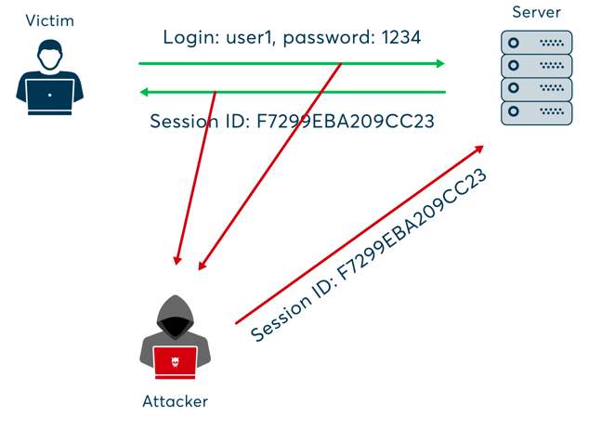
Session
Hijacking
Using Packet Sniffer
Notes:
As more devices become internet-enabled and accessible and the security measures in place continue to lag behind, the associated risks are on the rise. Aside from the obvious risks for attacks on consumer IoT devices, there is a growing threat against industrial and municipal IoT as well. As leading manufacturers and grid power producers transition to Industry 4.0, sufficient safeguards are lacking. Not only do these IoT devices run the risk of being used to attack others, but their vulnerabilities leave them open to being used against the industrial organizations operating critical infrastructure themselves. This can lead to theft of intellectual property, collecting competitive intelligence, and even the disruption or destruction of critical infrastructure. Not only is the potential scale of these attacks larger, most of these industrial firms do not have the skills in place to deal with web attacks in real-time, which can cause long-lasting, damaging results. This alone will become one of the greatest threats that countries and corporations need to brace themselves for in 2017 and beyond.
There are plenty of "As-A- Service" attack capabilities on the Dark Web for hire now and we should expect creative new IoT hack services to pop up in the near future.
As organizations adopt more effective strategies to defeat malware, attackers will shift their approach and start to use legitimate credentials and software - think physical insiders, credential theft, man-in-the-app. The increased targeting of social media and personal email bypasses many network defenses, like email scans and URL filters. The most dangerous aspect is how attackers manipulate victims with offers or threats that they would not want to present to an employer, like employment offers or illicit content. Defenders will begin to appreciate that inconsistent user behaviors are the most effective way to differentiate malware and insider threats from safe and acceptable content.

Slide 37
Session Hijacking - Mitigation Techniques
Use HTTPS to ensure SSL/TLS encryption of all session traffic
Set the HttpOnly attribute using the Set-Cookie HTTP header to prevent access to cookies from client-side scripts.
Web frameworks offer highly secure and well-tested session ID generation and management mechanisms
Regenerate the session key after initial authentication.
Perform additional user identity verification beyond the session key.
Notes:
As more devices become internet-enabled and accessible and the security measures in place continue to lag behind, the associated risks are on the rise. Aside from the obvious risks for attacks on consumer IoT devices, there is a growing threat against industrial and municipal IoT as well. As leading manufacturers and grid power producers transition to Industry 4.0, sufficient safeguards are lacking. Not only do these IoT devices run the risk of being used to attack others, but their vulnerabilities leave them open to being used against the industrial organizations operating critical infrastructure themselves. This can lead to theft of intellectual property, collecting competitive intelligence, and even the disruption or destruction of critical infrastructure. Not only is the potential scale of these attacks larger, most of these industrial firms do not have the skills in place to deal with web attacks in real-time, which can cause long-lasting, damaging results. This alone will become one of the greatest threats that countries and corporations need to brace themselves for in 2017 and beyond.
There are plenty of "As-A- Service" attack capabilities on the Dark Web for hire now and we should expect creative new IoT hack services to pop up in the near future.
As organizations adopt more effective strategies to defeat malware, attackers will shift their approach and start to use legitimate credentials and software - think physical insiders, credential theft, man-in-the-app. The increased targeting of social media and personal email bypasses many network defenses, like email scans and URL filters. The most dangerous aspect is how attackers manipulate victims with offers or threats that they would not want to present to an employer, like employment offers or illicit content. Defenders will begin to appreciate that inconsistent user behaviors are the most effective way to differentiate malware and insider threats from safe and acceptable content.

Slide 38
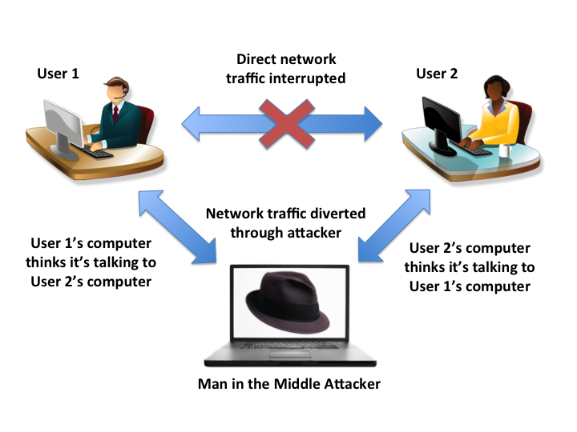
Man in the middle attack

Slide 39
MITM Attack - Mitigation Techniques
Avoiding WiFi connections that aren’t password protected.
Paying attention to browser notifications reporting a website as being unsecured
Immediately logging out of a secure application when it’s not in use
Not using public networks (e.g., coffee shops, hotels) when conducting sensitive transactions
Notes:
As more devices become internet-enabled and accessible and the security measures in place continue to lag behind, the associated risks are on the rise. Aside from the obvious risks for attacks on consumer IoT devices, there is a growing threat against industrial and municipal IoT as well. As leading manufacturers and grid power producers transition to Industry 4.0, sufficient safeguards are lacking. Not only do these IoT devices run the risk of being used to attack others, but their vulnerabilities leave them open to being used against the industrial organizations operating critical infrastructure themselves. This can lead to theft of intellectual property, collecting competitive intelligence, and even the disruption or destruction of critical infrastructure. Not only is the potential scale of these attacks larger, most of these industrial firms do not have the skills in place to deal with web attacks in real-time, which can cause long-lasting, damaging results. This alone will become one of the greatest threats that countries and corporations need to brace themselves for in 2017 and beyond.
There are plenty of "As-A- Service" attack capabilities on the Dark Web for hire now and we should expect creative new IoT hack services to pop up in the near future.
As organizations adopt more effective strategies to defeat malware, attackers will shift their approach and start to use legitimate credentials and software - think physical insiders, credential theft, man-in-the-app. The increased targeting of social media and personal email bypasses many network defenses, like email scans and URL filters. The most dangerous aspect is how attackers manipulate victims with offers or threats that they would not want to present to an employer, like employment offers or illicit content. Defenders will begin to appreciate that inconsistent user behaviors are the most effective way to differentiate malware and insider threats from safe and acceptable content.

Slide 40
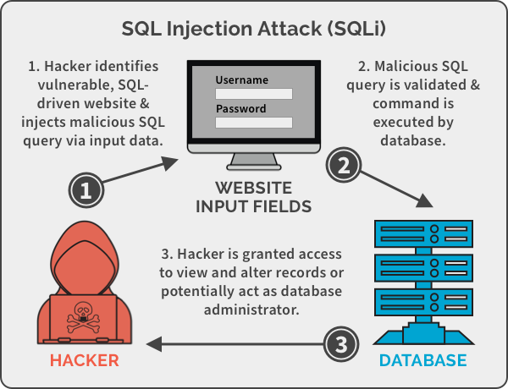
SQL injection

Slide 41
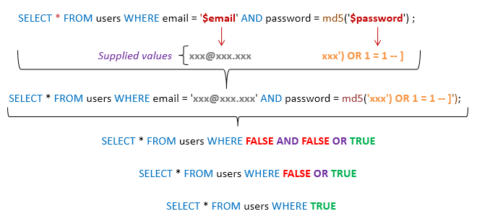
SQL injection - Example

Slide 42
SQL injection Attack - Mitigation Techniques
Train and maintain awareness
Don't trust any user input
Use Whitelists, not blacklists
Use latest development environment and their associated technologies. Example: PHP use PDO instead of SQLi
Notes:
As more devices become internet-enabled and accessible and the security measures in place continue to lag behind, the associated risks are on the rise. Aside from the obvious risks for attacks on consumer IoT devices, there is a growing threat against industrial and municipal IoT as well. As leading manufacturers and grid power producers transition to Industry 4.0, sufficient safeguards are lacking. Not only do these IoT devices run the risk of being used to attack others, but their vulnerabilities leave them open to being used against the industrial organizations operating critical infrastructure themselves. This can lead to theft of intellectual property, collecting competitive intelligence, and even the disruption or destruction of critical infrastructure. Not only is the potential scale of these attacks larger, most of these industrial firms do not have the skills in place to deal with web attacks in real-time, which can cause long-lasting, damaging results. This alone will become one of the greatest threats that countries and corporations need to brace themselves for in 2017 and beyond.
There are plenty of "As-A- Service" attack capabilities on the Dark Web for hire now and we should expect creative new IoT hack services to pop up in the near future.
As organizations adopt more effective strategies to defeat malware, attackers will shift their approach and start to use legitimate credentials and software - think physical insiders, credential theft, man-in-the-app. The increased targeting of social media and personal email bypasses many network defenses, like email scans and URL filters. The most dangerous aspect is how attackers manipulate victims with offers or threats that they would not want to present to an employer, like employment offers or illicit content. Defenders will begin to appreciate that inconsistent user behaviors are the most effective way to differentiate malware and insider threats from safe and acceptable content.

Slide 43
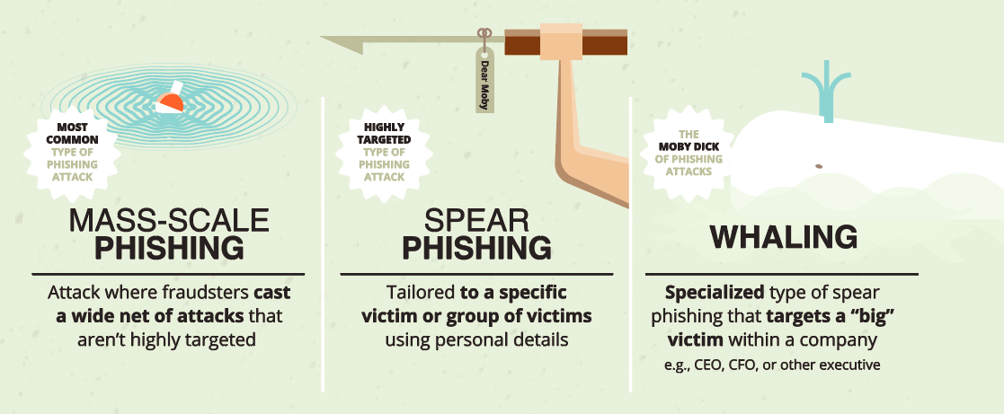
Phishing Attack Types

Slide 44
Phishing- Mitigation Techniques
Critical thinking —models are trained to identify micro behaviours ( email headers, subsamples of body-data, punctuation patterns, etc.
Hovering over the links — Move your mouse over the link, but do not click it! Just let your mouse cursor h over over the link and see where would actually take you. Apply critical thinking to decipher the URL.
Analyzing email headers — Email headers define how an email got to your address. The “Reply-to” and “Return-Path” parameters should lead to the same domain as is stated in the email.
Sandboxing — You can test email content in a sandbox environment, logging activity from opening the attachment or clicking the links inside the email.
Notes:
As more devices become internet-enabled and accessible and the security measures in place continue to lag behind, the associated risks are on the rise. Aside from the obvious risks for attacks on consumer IoT devices, there is a growing threat against industrial and municipal IoT as well. As leading manufacturers and grid power producers transition to Industry 4.0, sufficient safeguards are lacking. Not only do these IoT devices run the risk of being used to attack others, but their vulnerabilities leave them open to being used against the industrial organizations operating critical infrastructure themselves. This can lead to theft of intellectual property, collecting competitive intelligence, and even the disruption or destruction of critical infrastructure. Not only is the potential scale of these attacks larger, most of these industrial firms do not have the skills in place to deal with web attacks in real-time, which can cause long-lasting, damaging results. This alone will become one of the greatest threats that countries and corporations need to brace themselves for in 2017 and beyond.
There are plenty of "As-A- Service" attack capabilities on the Dark Web for hire now and we should expect creative new IoT hack services to pop up in the near future.
As organizations adopt more effective strategies to defeat malware, attackers will shift their approach and start to use legitimate credentials and software - think physical insiders, credential theft, man-in-the-app. The increased targeting of social media and personal email bypasses many network defenses, like email scans and URL filters. The most dangerous aspect is how attackers manipulate victims with offers or threats that they would not want to present to an employer, like employment offers or illicit content. Defenders will begin to appreciate that inconsistent user behaviors are the most effective way to differentiate malware and insider threats from safe and acceptable content.

Slide 45
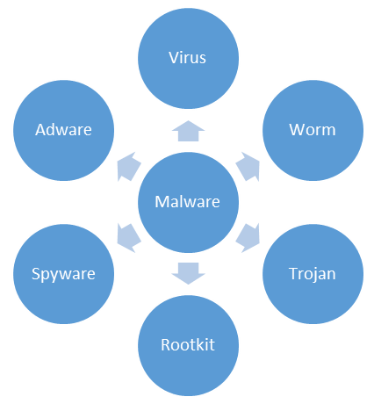
System Based Attacks - Malware
Malware (malicious software) typically consists of code developed by cyberattackers, designed to cause extensive damage to data and systems or to gain unauthorized access to a network.
Notes:
As more devices become internet-enabled and accessible and the security measures in place continue to lag behind, the associated risks are on the rise. Aside from the obvious risks for attacks on consumer IoT devices, there is a growing threat against industrial and municipal IoT as well. As leading manufacturers and grid power producers transition to Industry 4.0, sufficient safeguards are lacking. Not only do these IoT devices run the risk of being used to attack others, but their vulnerabilities leave them open to being used against the industrial organizations operating critical infrastructure themselves. This can lead to theft of intellectual property, collecting competitive intelligence, and even the disruption or destruction of critical infrastructure. Not only is the potential scale of these attacks larger, most of these industrial firms do not have the skills in place to deal with web attacks in real-time, which can cause long-lasting, damaging results. This alone will become one of the greatest threats that countries and corporations need to brace themselves for in 2017 and beyond.
There are plenty of "As-A- Service" attack capabilities on the Dark Web for hire now and we should expect creative new IoT hack services to pop up in the near future.
As organizations adopt more effective strategies to defeat malware, attackers will shift their approach and start to use legitimate credentials and software - think physical insiders, credential theft, man-in-the-app. The increased targeting of social media and personal email bypasses many network defenses, like email scans and URL filters. The most dangerous aspect is how attackers manipulate victims with offers or threats that they would not want to present to an employer, like employment offers or illicit content. Defenders will begin to appreciate that inconsistent user behaviors are the most effective way to differentiate malware and insider threats from safe and acceptable content.

Slide 46
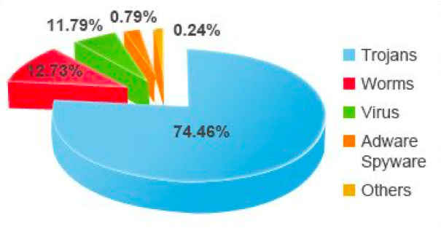
Malware Statistics
Notes:
As more devices become internet-enabled and accessible and the security measures in place continue to lag behind, the associated risks are on the rise. Aside from the obvious risks for attacks on consumer IoT devices, there is a growing threat against industrial and municipal IoT as well. As leading manufacturers and grid power producers transition to Industry 4.0, sufficient safeguards are lacking. Not only do these IoT devices run the risk of being used to attack others, but their vulnerabilities leave them open to being used against the industrial organizations operating critical infrastructure themselves. This can lead to theft of intellectual property, collecting competitive intelligence, and even the disruption or destruction of critical infrastructure. Not only is the potential scale of these attacks larger, most of these industrial firms do not have the skills in place to deal with web attacks in real-time, which can cause long-lasting, damaging results. This alone will become one of the greatest threats that countries and corporations need to brace themselves for in 2017 and beyond.
There are plenty of "As-A- Service" attack capabilities on the Dark Web for hire now and we should expect creative new IoT hack services to pop up in the near future.
As organizations adopt more effective strategies to defeat malware, attackers will shift their approach and start to use legitimate credentials and software - think physical insiders, credential theft, man-in-the-app. The increased targeting of social media and personal email bypasses many network defenses, like email scans and URL filters. The most dangerous aspect is how attackers manipulate victims with offers or threats that they would not want to present to an employer, like employment offers or illicit content. Defenders will begin to appreciate that inconsistent user behaviors are the most effective way to differentiate malware and insider threats from safe and acceptable content.

Slide 47
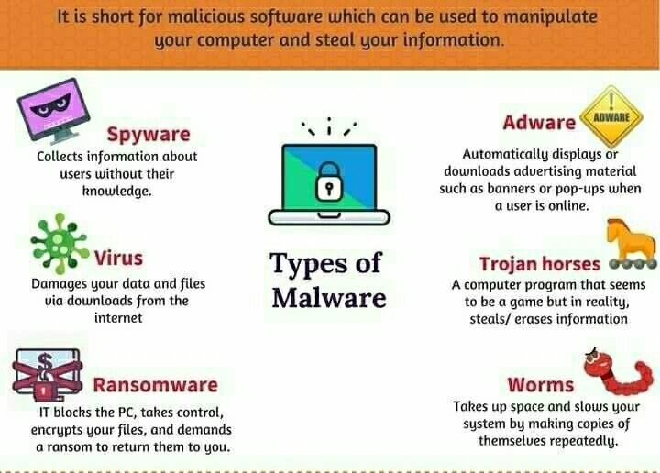
Notes:
As more devices become internet-enabled and accessible and the security measures in place continue to lag behind, the associated risks are on the rise. Aside from the obvious risks for attacks on consumer IoT devices, there is a growing threat against industrial and municipal IoT as well. As leading manufacturers and grid power producers transition to Industry 4.0, sufficient safeguards are lacking. Not only do these IoT devices run the risk of being used to attack others, but their vulnerabilities leave them open to being used against the industrial organizations operating critical infrastructure themselves. This can lead to theft of intellectual property, collecting competitive intelligence, and even the disruption or destruction of critical infrastructure. Not only is the potential scale of these attacks larger, most of these industrial firms do not have the skills in place to deal with web attacks in real-time, which can cause long-lasting, damaging results. This alone will become one of the greatest threats that countries and corporations need to brace themselves for in 2017 and beyond.
There are plenty of "As-A- Service" attack capabilities on the Dark Web for hire now and we should expect creative new IoT hack services to pop up in the near future.
As organizations adopt more effective strategies to defeat malware, attackers will shift their approach and start to use legitimate credentials and software - think physical insiders, credential theft, man-in-the-app. The increased targeting of social media and personal email bypasses many network defenses, like email scans and URL filters. The most dangerous aspect is how attackers manipulate victims with offers or threats that they would not want to present to an employer, like employment offers or illicit content. Defenders will begin to appreciate that inconsistent user behaviors are the most effective way to differentiate malware and insider threats from safe and acceptable content.

Slide 48
Botnet - Robot Network
A botnet is a collection of internet-connected devices infected by malware that allow hackers to control them.
Cyber criminals use botnets to instigate botnet attacks, which include malicious activities such as credentials leaks, unauthorized access, data theft and DDoS attacks.
Example:
Mirai Botnet 2016 - Massive DDOS attack - 600000 devices
A DDoS attack in August 2017 against an Akamai customer was observed to have originated from a botnet comprising more than 75,000 bots
Notes:
As more devices become internet-enabled and accessible and the security measures in place continue to lag behind, the associated risks are on the rise. Aside from the obvious risks for attacks on consumer IoT devices, there is a growing threat against industrial and municipal IoT as well. As leading manufacturers and grid power producers transition to Industry 4.0, sufficient safeguards are lacking. Not only do these IoT devices run the risk of being used to attack others, but their vulnerabilities leave them open to being used against the industrial organizations operating critical infrastructure themselves. This can lead to theft of intellectual property, collecting competitive intelligence, and even the disruption or destruction of critical infrastructure. Not only is the potential scale of these attacks larger, most of these industrial firms do not have the skills in place to deal with web attacks in real-time, which can cause long-lasting, damaging results. This alone will become one of the greatest threats that countries and corporations need to brace themselves for in 2017 and beyond.
There are plenty of "As-A- Service" attack capabilities on the Dark Web for hire now and we should expect creative new IoT hack services to pop up in the near future.
As organizations adopt more effective strategies to defeat malware, attackers will shift their approach and start to use legitimate credentials and software - think physical insiders, credential theft, man-in-the-app. The increased targeting of social media and personal email bypasses many network defenses, like email scans and URL filters. The most dangerous aspect is how attackers manipulate victims with offers or threats that they would not want to present to an employer, like employment offers or illicit content. Defenders will begin to appreciate that inconsistent user behaviors are the most effective way to differentiate malware and insider threats from safe and acceptable content.

Slide 49
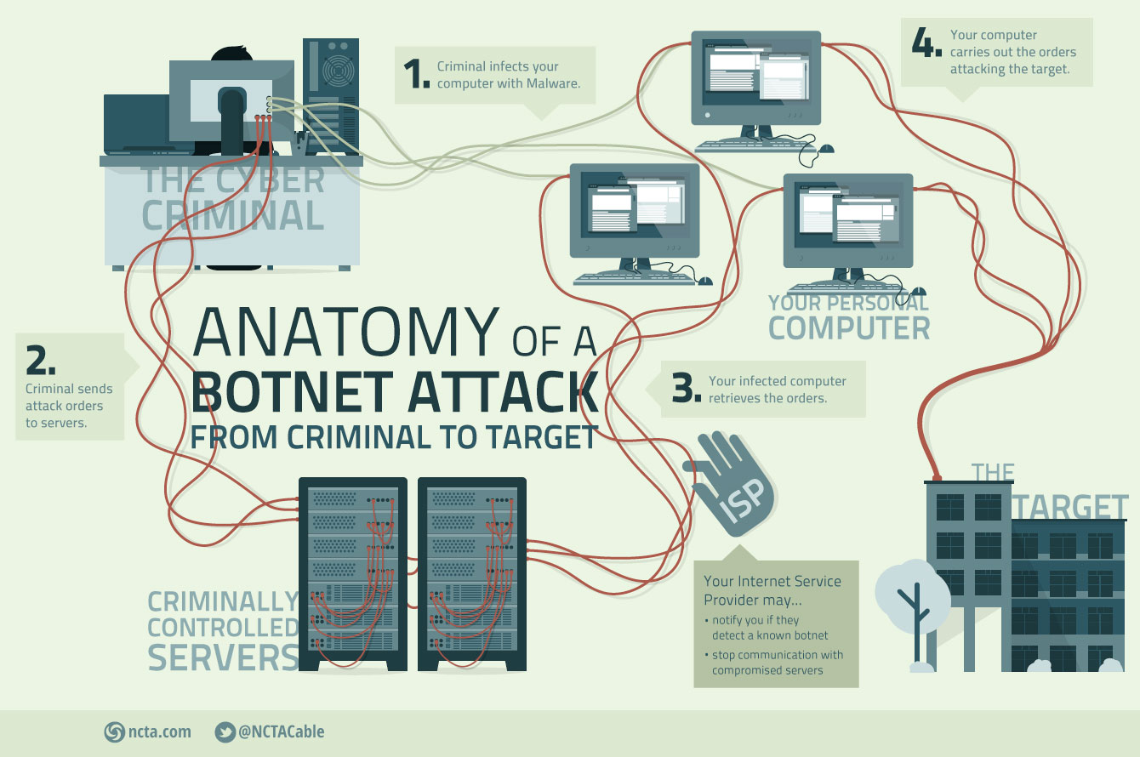
Botnet
Notes:
As more devices become internet-enabled and accessible and the security measures in place continue to lag behind, the associated risks are on the rise. Aside from the obvious risks for attacks on consumer IoT devices, there is a growing threat against industrial and municipal IoT as well. As leading manufacturers and grid power producers transition to Industry 4.0, sufficient safeguards are lacking. Not only do these IoT devices run the risk of being used to attack others, but their vulnerabilities leave them open to being used against the industrial organizations operating critical infrastructure themselves. This can lead to theft of intellectual property, collecting competitive intelligence, and even the disruption or destruction of critical infrastructure. Not only is the potential scale of these attacks larger, most of these industrial firms do not have the skills in place to deal with web attacks in real-time, which can cause long-lasting, damaging results. This alone will become one of the greatest threats that countries and corporations need to brace themselves for in 2017 and beyond.
There are plenty of "As-A- Service" attack capabilities on the Dark Web for hire now and we should expect creative new IoT hack services to pop up in the near future.
As organizations adopt more effective strategies to defeat malware, attackers will shift their approach and start to use legitimate credentials and software - think physical insiders, credential theft, man-in-the-app. The increased targeting of social media and personal email bypasses many network defenses, like email scans and URL filters. The most dangerous aspect is how attackers manipulate victims with offers or threats that they would not want to present to an employer, like employment offers or illicit content. Defenders will begin to appreciate that inconsistent user behaviors are the most effective way to differentiate malware and insider threats from safe and acceptable content.

Slide 50
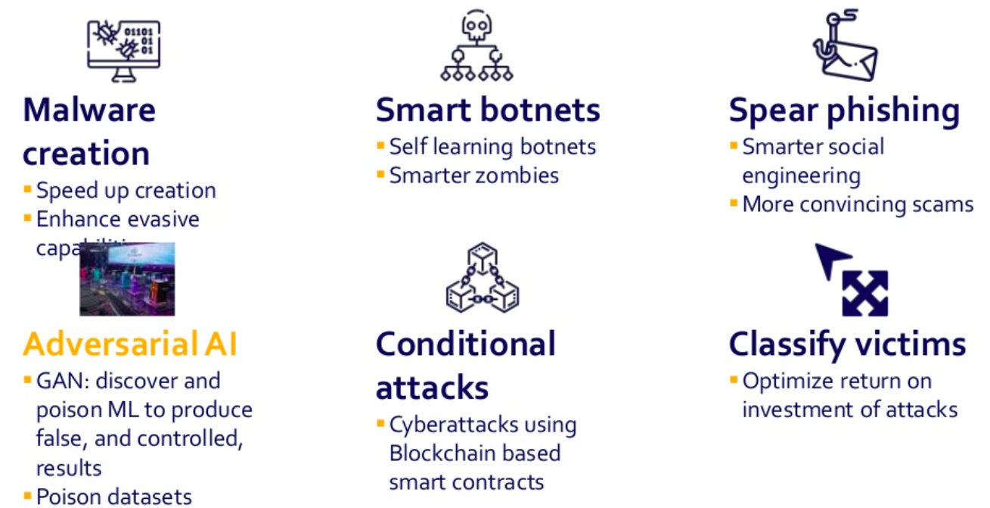
AI enhanced Cyber Attacks
Notes:
As more devices become internet-enabled and accessible and the security measures in place continue to lag behind, the associated risks are on the rise. Aside from the obvious risks for attacks on consumer IoT devices, there is a growing threat against industrial and municipal IoT as well. As leading manufacturers and grid power producers transition to Industry 4.0, sufficient safeguards are lacking. Not only do these IoT devices run the risk of being used to attack others, but their vulnerabilities leave them open to being used against the industrial organizations operating critical infrastructure themselves. This can lead to theft of intellectual property, collecting competitive intelligence, and even the disruption or destruction of critical infrastructure. Not only is the potential scale of these attacks larger, most of these industrial firms do not have the skills in place to deal with web attacks in real-time, which can cause long-lasting, damaging results. This alone will become one of the greatest threats that countries and corporations need to brace themselves for in 2017 and beyond.
There are plenty of "As-A- Service" attack capabilities on the Dark Web for hire now and we should expect creative new IoT hack services to pop up in the near future.
As organizations adopt more effective strategies to defeat malware, attackers will shift their approach and start to use legitimate credentials and software - think physical insiders, credential theft, man-in-the-app. The increased targeting of social media and personal email bypasses many network defenses, like email scans and URL filters. The most dangerous aspect is how attackers manipulate victims with offers or threats that they would not want to present to an employer, like employment offers or illicit content. Defenders will begin to appreciate that inconsistent user behaviors are the most effective way to differentiate malware and insider threats from safe and acceptable content.

Slide 51
Essential Security Controls
Firewall and Internet gateways
Network perimeter defences
Web proxy
Web filtering
Content Checking
Firewall Policies
Malware Protection
Patch Management
Secure Configuration
Password Policy
User Access Control
Security Incident Management
Notes:
As more devices become internet-enabled and accessible and the security measures in place continue to lag behind, the associated risks are on the rise. Aside from the obvious risks for attacks on consumer IoT devices, there is a growing threat against industrial and municipal IoT as well. As leading manufacturers and grid power producers transition to Industry 4.0, sufficient safeguards are lacking. Not only do these IoT devices run the risk of being used to attack others, but their vulnerabilities leave them open to being used against the industrial organizations operating critical infrastructure themselves. This can lead to theft of intellectual property, collecting competitive intelligence, and even the disruption or destruction of critical infrastructure. Not only is the potential scale of these attacks larger, most of these industrial firms do not have the skills in place to deal with web attacks in real-time, which can cause long-lasting, damaging results. This alone will become one of the greatest threats that countries and corporations need to brace themselves for in 2017 and beyond.
There are plenty of "As-A- Service" attack capabilities on the Dark Web for hire now and we should expect creative new IoT hack services to pop up in the near future.
As organizations adopt more effective strategies to defeat malware, attackers will shift their approach and start to use legitimate credentials and software - think physical insiders, credential theft, man-in-the-app. The increased targeting of social media and personal email bypasses many network defenses, like email scans and URL filters. The most dangerous aspect is how attackers manipulate victims with offers or threats that they would not want to present to an employer, like employment offers or illicit content. Defenders will begin to appreciate that inconsistent user behaviors are the most effective way to differentiate malware and insider threats from safe and acceptable content.

Slide 52
Research Areas
IOT Security
Cloud Security
Cyber attacks on Deep learning models
DL approach for various cyber attacks
Cyber threat prediction and self configuring networks
Reverse Engineering and vulnerability analysis
Stegnography
Smart Phishing
Use of Deep Learning to respond to cyber attacks
Malware analysis using neural networks
Mobile Protection
Social Engineering
BOT Detection
Advanced heuristics to detect zero-day attacks
Notes:
As more devices become internet-enabled and accessible and the security measures in place continue to lag behind, the associated risks are on the rise. Aside from the obvious risks for attacks on consumer IoT devices, there is a growing threat against industrial and municipal IoT as well. As leading manufacturers and grid power producers transition to Industry 4.0, sufficient safeguards are lacking. Not only do these IoT devices run the risk of being used to attack others, but their vulnerabilities leave them open to being used against the industrial organizations operating critical infrastructure themselves. This can lead to theft of intellectual property, collecting competitive intelligence, and even the disruption or destruction of critical infrastructure. Not only is the potential scale of these attacks larger, most of these industrial firms do not have the skills in place to deal with web attacks in real-time, which can cause long-lasting, damaging results. This alone will become one of the greatest threats that countries and corporations need to brace themselves for in 2017 and beyond.
There are plenty of "As-A- Service" attack capabilities on the Dark Web for hire now and we should expect creative new IoT hack services to pop up in the near future.
As organizations adopt more effective strategies to defeat malware, attackers will shift their approach and start to use legitimate credentials and software - think physical insiders, credential theft, man-in-the-app. The increased targeting of social media and personal email bypasses many network defenses, like email scans and URL filters. The most dangerous aspect is how attackers manipulate victims with offers or threats that they would not want to present to an employer, like employment offers or illicit content. Defenders will begin to appreciate that inconsistent user behaviors are the most effective way to differentiate malware and insider threats from safe and acceptable content.

Slide 53
Thank You!
https://www.linkedin.com/in/rekharavindirran/
https://www.linkedin.com/in/rekharavindirran/
Notes:
As more devices become internet-enabled and accessible and the security measures in place continue to lag behind, the associated risks are on the rise. Aside from the obvious risks for attacks on consumer IoT devices, there is a growing threat against industrial and municipal IoT as well. As leading manufacturers and grid power producers transition to Industry 4.0, sufficient safeguards are lacking. Not only do these IoT devices run the risk of being used to attack others, but their vulnerabilities leave them open to being used against the industrial organizations operating critical infrastructure themselves. This can lead to theft of intellectual property, collecting competitive intelligence, and even the disruption or destruction of critical infrastructure. Not only is the potential scale of these attacks larger, most of these industrial firms do not have the skills in place to deal with web attacks in real-time, which can cause long-lasting, damaging results. This alone will become one of the greatest threats that countries and corporations need to brace themselves for in 2017 and beyond.
There are plenty of "As-A- Service" attack capabilities on the Dark Web for hire now and we should expect creative new IoT hack services to pop up in the near future.
As organizations adopt more effective strategies to defeat malware, attackers will shift their approach and start to use legitimate credentials and software - think physical insiders, credential theft, man-in-the-app. The increased targeting of social media and personal email bypasses many network defenses, like email scans and URL filters. The most dangerous aspect is how attackers manipulate victims with offers or threats that they would not want to present to an employer, like employment offers or illicit content. Defenders will begin to appreciate that inconsistent user behaviors are the most effective way to differentiate malware and insider threats from safe and acceptable content.

